Slide 1
JR3 Webinar
Software Release – New HR

Slide 2
Coming Soon
WebSmart is excited to announce the new version of HR & Payroll.
Be prepared in advance.
Coming June 2015.
Notes:
Introductions
Go over Day 1 Agenda

Slide 3
Available Webinars - HR
Feel free to attend any or all of our training sessions to discuss these new changes.
Monday, May 11th 1:00 pm – 5:00 pm
Wednesday, May 20th 1:00 pm – 5:00 pm
Tuesday, May 26th 1:00 pm – 5:00 pm
Notes:
Introductions
Go over Day 1 Agenda

Slide 4
Conversion Schedule
We are developing a conversion schedule this week and submit to the individual districts as soon as it becomes available.
Notes:
Introductions
Go over Day 1 Agenda

Slide 5
Introduction/Goals
Welcome and thank you for joining us today.
Introduction of Presenters
Melissa Davis – mdavis@jr3online.com
CTSBS Certification in Accounting
Annette Miller – amiller@jr3online.com
Notes:
Introductions
Go over Day 1 Agenda

Slide 6
Introduction/Goals
Today’s Agenda
Discuss new features in HR Setup
Setting payroll and liability default codes
Tracking endorsements and highly qualified staff
Addition of Associate’s Degree in Degree Types
Assigning Leave Policies instead of Leave Groups
Roles of Contract Types
Promoting Contracts instead of Service Records
Discuss new features in HR Staff Manager
How to set up a new employee
Click here for Documentation and Power Points
Notes:
Introductions
Go over Day 1 Agenda

Slide 7
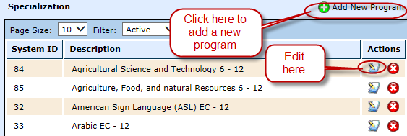
New HR Setup - Specialization
Finance > HR > Support Codes > Specialization
The current list of specialization certifications listed on this screen are preloaded from SBOE’s list of endorsements available to date.
These certifications are added to the employee’s HR record on the Certifications tab.
Can be edited and changed.
Can Add New Program.
Notes:
Introductions
Go over Day 1 Agenda

Slide 8
New HR Setup - Specialization
Finance > HR > Support Codes > Specialization
To Add New Program
Click on Add New Program
Enter a description of the certification
Select Create
Notes:
Introductions
Go over Day 1 Agenda

Slide 9
New HR Setup – Certification Source
Finance > HR > Support Codes > Cert. Source
This new feature indicates the source of the specialization, whether it be an alternative certification source or SBOE.
(Note: When setting up a certification in HR > Staff Manager, you will be prompted to select the source of the specialization.)
Notes:
Introductions
Go over Day 1 Agenda

Slide 10
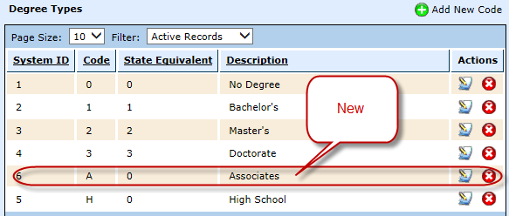
New HR Setup – Degree Types
Finance > HR > Support Codes > Degree Type
This is an existing feature; however, the Associate’s Degree has been added as a selection.
The Associate’s Degree can be selected, if appropriate, on the employee’s HR record on the HR Info tab under General HR Attributes.
Notes:
Introductions
Go over Day 1 Agenda

Slide 11
Leave Policies
Finance > HR > Leave > Leave Policies
Leave Policies have been created to replace the former Leave Groups.
Leave Policies are designed according to each district's local policy. Leave Policy Examples:
Standard Leave Group
Maintenance/Custodial
Non-Eligible Employees
Superintendent
Leave Policies are assigned to an employee in Finance > HR > Staff Manager > Leave Policy Elections.
Notes:
Introductions
Go over Day 1 Agenda

Slide 12
Leave Policies
Leave Policies are designed to have multiple functions in the payroll process:
Accrual: Leave Polices are created to accrue specified Leave Types to a group of employees for a particular time period such as by pay period or annually. Again, this is initially set up according to your local leave policy.
For example, this process simplifies accruing the state personal days and/or local days at the beginning of each school year.
Dock: Leave Policies also contain the option to dock employee leave given entered criteria for Days of Grace, Days of Reduced Dock, Reduced Dock Method, and the Reduced Dock Rate.
For example, if an employee is absent due to FMLA reasons and district policy indicates that the employee shall be docked at a lower daily rate instead of his/her daily rate of pay, the information would be entered here.
Notes:
Introductions
Go over Day 1 Agenda

Slide 13
Leave Policies
Finance > HR > Leave > Leave Policies
Adding Leave Policy
Select Add Leave Policy
Notes:
Introductions
Go over Day 1 Agenda

Slide 14
Leave Policies
Name – Enter the name of the leave policy
Select Create
Select the Configuration tab
Select Edit Identifier
Notes:
Introductions
Go over Day 1 Agenda

Slide 15
Leave Policies
Effective Date – Enter the effective date of the leave policy.
Select Save
Notes:
Introductions
Go over Day 1 Agenda

Slide 16
Leave Policies
Select 0 Leave Types in the Configure section
Notes:
Introductions
Go over Day 1 Agenda

Slide 17
Leave Policies
Select Add Leave Type
Notes:
Introductions
Go over Day 1 Agenda

Slide 18
Leave Policies
Enter the information for the Leave Policy Configuration
Leave Type - Select the leave type.
Accrual Period -Select the accrual period.
Annual - this option will accrue the Leave Type annually during the Promote Contracts process.
By Pay Period - this option will accrue the Leave Type each pay period during the payroll process.
Accrual Units - Enter the accrual units for the period.
Accrual Limit - Enter the accrual limit for the leave type or leave blank for no limit
Carry Forward Limit - Enter the carry forward limit for the leave type or leave blank for no limit
Grace Units - Enter the grace units of the leave if the policy allows days of grace before an employee is docked his/her full daily rate.
Reduced Units - Enter the reduced units of the local leave if the policy allows days of reduced dock before an employee is docked her/her full daily rate.
Reduced Calc Method - Select the reduced calc method from the drop down box choosing the flat amount or percentage method.
Reduced Dock Rate - Enter the reduced dock rate if local leave policy docks an employee at a reduced dock. For example, a school may dock at a reduced substitute rate rather than an employee's full daily rate
Select Save
Notes:
Introductions
Go over Day 1 Agenda

Slide 19
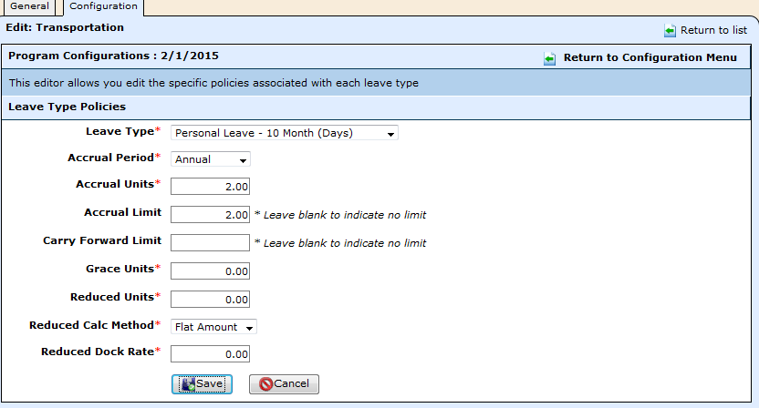
Leave Policies
Example of a Leave Policy Configuration
Notes:
Introductions
Go over Day 1 Agenda

Slide 20
Leave Policies
Continue the same procedures until all appropriate leave is added to the policy.
Select Return to Configuration to see the following screen.
Notes:
Introductions
Go over Day 1 Agenda

Slide 21
Leave Types
Finance > HR > Leave > Leave Types
Leave Types are created to serve the following functions:
to categorize employee leave by type when leave forms are created
to track and maintain the balance of state days, which should print on the employee service record
Notes:
Introductions
Go over Day 1 Agenda

Slide 22
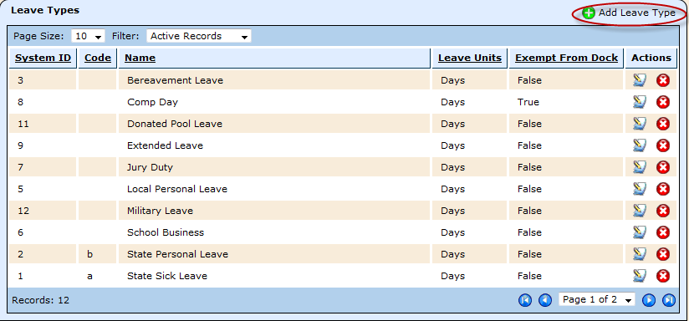
Leave Types
To add a leave type, select Add Leave Type
Notes:
Introductions
Go over Day 1 Agenda

Slide 23
Leave Types
Code - Leave this field blank unless it's to be recorded on the employee service record such as State Personal or State Sick leave as follows:
a - State Sick
b - State Personal
All others are not to be recorded on the employee service record
Name – Enter the name of the leave type
Units - Select Days or Hours in the drop down box
Select Create
Notes:
Introductions
Go over Day 1 Agenda

Slide 24
Leave Types
Exempt from Dock –
This field appears as the leave type is created.
It will always default to – False – Dock in accordance with employee policy.
If this should leave type should NOT dock follow the next steps
Notes:
Introductions
Go over Day 1 Agenda

Slide 25
Leave Types
To determine whether or not a leave type is exempt from docking an employee’s pay, click on Edit Identifier
Exempt from Dock – Use drop down box to select if the leave type should NOT be docked
Notes:
Introductions
Go over Day 1 Agenda

Slide 26
Position Types
Finance > HR > Organization > Position Types
A position type maps a state defined position to a locally implemented position type. This categorization is critical to the following areas:
The position templates are used when setting up a new position on an employee in Finance > HR > Staff Manager in TRAQS and PEIMS reporting.
Setting up access for teachers in the student service module.
Notes:
Introductions
Go over Day 1 Agenda

Slide 27
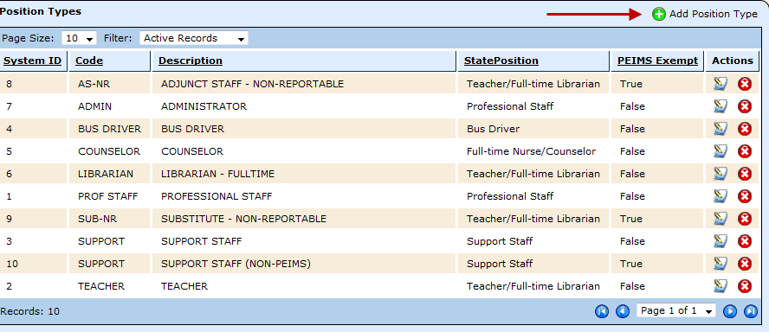
Position Types
To add a new position type
Select Add Position Type
Notes:
Introductions
Go over Day 1 Agenda

Slide 28
Position Types
Code – Enter a short code (abbreviation) for the position type. This code will print on the employee’s service record (up to 10 characters)
Description – Enter a description of the position.
Examples: Teacher, Professional, Aide, Maintenance.
State Position – Select the appropriate state position for TRS reporting purposes
Click Create to save the Position Type.
Notes:
Introductions
Go over Day 1 Agenda

Slide 29
Position Types
Once the Position Type is created, the PEIMS exempt box will appear.
The PEIMS Exempt prompt defaults to False – Report to PEIMS.
If you do not want to report a Position Type to PEIMS, select Edit Identifier.
Notes:
Introductions
Go over Day 1 Agenda

Slide 30
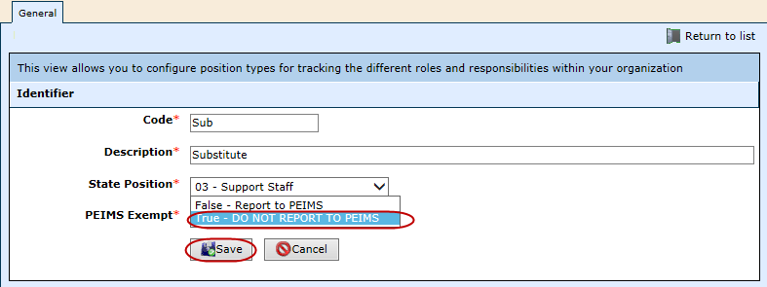
Position Types
PEIMS Exempt –
Select TRUE – DO NOT REPORT TO PEIMS
Select Save
Notes:
Introductions
Go over Day 1 Agenda

Slide 31
Position Types
PEIMS Exempt –
Select TRUE – DO NOT REPORT TO PEIMS
Select Save
Notes:
Introductions
Go over Day 1 Agenda

Slide 32
Contract Types
Finance > HR > Organization > Contract Types
Created to identify the following:
# of days an employee works
# of pay checks
Do not create a contract type for an employee that has been hired mid-year. Select one of the standard contract types.
Notes:
Introductions
Go over Day 1 Agenda

Slide 33
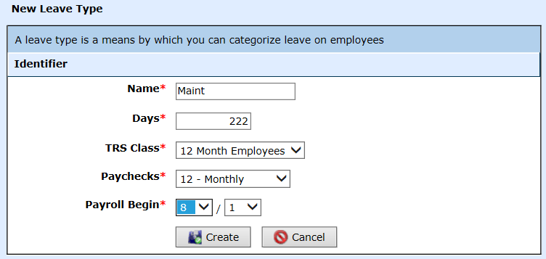
Contract Types
Name- Enter a name for the Contract Type. Example: 10 month, 12 month, Admin
Days– Enter the number of days of the contract type
TRS Class – Select the appropriate TRS Class as mandated by TRS from the drop down box.
Paychecks – Select the # of paychecks for the school year.
Payroll Begin– Select the month and the day from the drop down boxes in which the contract should begin during a school year.
Select Create
Notes:
Introductions
Go over Day 1 Agenda

Slide 34
Promote Contracts
Finance > HR > Organization > Promote Contract
Replaces Promote Service Records
By selecting the Target Period, the Contract Begin and Contract End dates will populate according to the general ledger dates. This will need to be adjusted according to your calendar for your contract types.
Notes:
Introductions
Go over Day 1 Agenda

Slide 35
Promote Contracts
Finance > HR > Organization > Promote Contract
New – the ability to promote raises for each compensation type.
This feature will increase the employees’ raises according to the % increase selected for that particular compensation type.
The compensation type is selected on the employee’s position.
Notes:
Introductions
Go over Day 1 Agenda

Slide 36
Break
Please take this time to take a brief break.

Slide 37
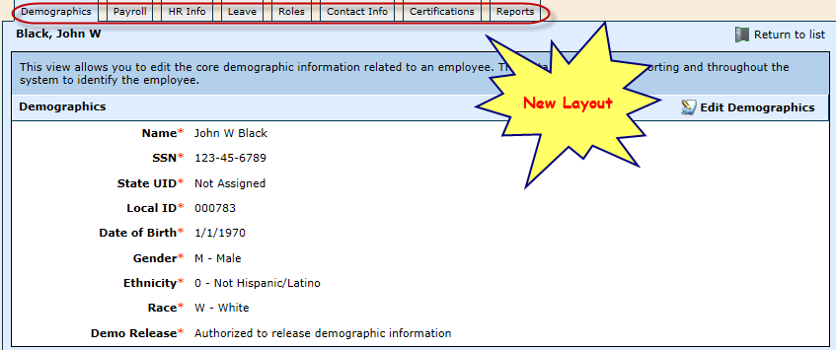
Staff Manager - Overview
Finance > HR > Staff Manager
Overview of the new layout
New user friendly tab menus.
Modeled after the Student Module – ease of cross training
Notes:
Introductions
Go over Day 1 Agenda

Slide 38
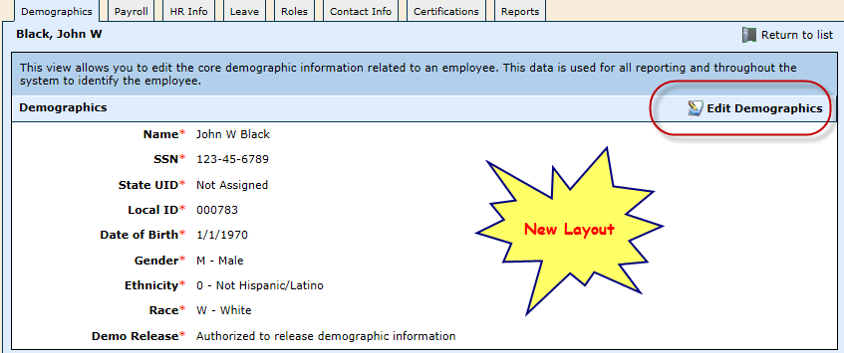
Staff Manager - Demographics
Finance > HR > Staff Manager
Select Edit Demographics
Notes:
Introductions
Go over Day 1 Agenda

Slide 39
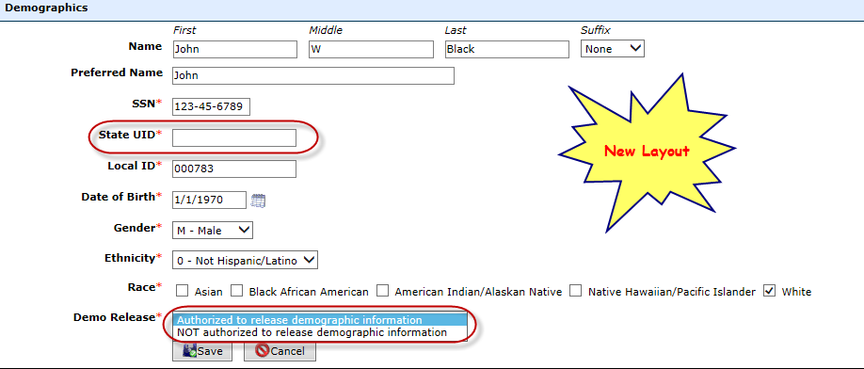
Staff Manager - Demographics
Contains demographic data used in PEIMS reporting
Demo Release – Select whether or not the employee has authorized release of his/her demographic information. (Note: When adding a new employee, this prompt does not appear until the screen is edited.)
Notes:
Introductions
Go over Day 1 Agenda

Slide 40
Staff Manager - Contracts
The contract contains service record and contract information used in payroll processing and printing service records. All employees must have a contract to be included in the payroll process.
Contracts replace the Service Record.
Notes:
Introductions
Go over Day 1 Agenda

Slide 41
Staff Manager - Contracts
Finance > HR > Staff Manager > Payroll Tab
Select Add Contract
Notes:
Introductions
Go over Day 1 Agenda

Slide 42
Staff Manager - Contracts
Contract Type - Select the appropriate contract type from the drop down box. FTE – Employee or Contractor.
District – Select the district for which the employee works.
Instructional Period – Select the instructional period.
Notes:
Introductions
Go over Day 1 Agenda

Slide 43
Staff Manager - Contracts
Contract Type – This indicates the # of days or months the employee’s contract contains.
Contract Days - Enter the # of contract days of the employee’s contract:
•If an employee is on a 187 day contract and is working full time, enter 187 days in this field.
•If an employee came in mid-year and is only working 90 days out of the 187 day contract, enter 90 in this field.
Contract Begin – This field should indicate the date of the employees first day of the employee contract.
Contract End – This field should indicate the last day of the employees contract.
Status – Select the appropriate employment status box.
Notes:
Introductions
Go over Day 1 Agenda

Slide 44
Staff Manager - Contracts
Primary Role – Select the primary position from the drop down box. If the employee has a position that is exempt from PEIMS, select the position that indicates it is not a reportable position.
Percent of Day – Select the % of day. This indicates the % of the day that the employee works for the district.
Pay Step – Enter the pay step of the employee (if applicable).
Local Experience – Enter the # of years experience the employee has had at the district.
Professional Experience – Enter the # of years experience the employee has had in all school districts. (information comes from prior service records).
Notes:
Introductions
Go over Day 1 Agenda

Slide 45
Staff Manager - Contracts
Statutory Tax Status – Select the appropriate statutory taxes for the employee from the drop down box. (This section will not appear if the individual is selected as a Contractor.)
Ineligible for all statutory adjustments – H1B Visa employees
Medicare eligible only – retired employees
Fica and Medicare eligible – substitutes
State retirement eligible only – employees who have been in continuous employment with the employer since March 31, 1986 are not subject to the mandatory Medicare provisions. Click here to view eligibility
State retirement and Medicare eligible – the norm for most staff contributing to TRS
FICA, Medicare and State Retirement eligible – for schools districts that participate in FICA and TRS options
Notes:
Introductions
Go over Day 1 Agenda

Slide 46
Staff Manager - Contracts
FUTA Exempt – Select if the employee is FUTA eligible.
True – FUTA Taxes DO NOT apply to this employee
False – FUTA Taxes apply to this employee
Click here to view eligibility
SUTA Exempt – Select if the employee is SUTA eligible.
False – SUTA Taxes apply to this employee – Applies to most employees
True – SUTA Taxes DO NOT apply to this employee – some superintendents may be considered SUTA Exempt
Overtime Exempt – Select if the employee is eligible for overtime.
True – Employee is NOT eligible for overtime –applies to exempt employees
False – Employee is eligible for overtime – applies to nonexempt employees
Notes:
Introductions
Go over Day 1 Agenda

Slide 47
Staff Manager - Positions
Finance > HR > Staff Manager – Payroll tab, Positions
Select to edit the position
Select to edit the contract
Select to terminate the employee and calculate the payoff
Select to delete the position. The position can only be deleted if it has not been linked to a payroll.
Notes:
Introductions
Go over Day 1 Agenda

Slide 48
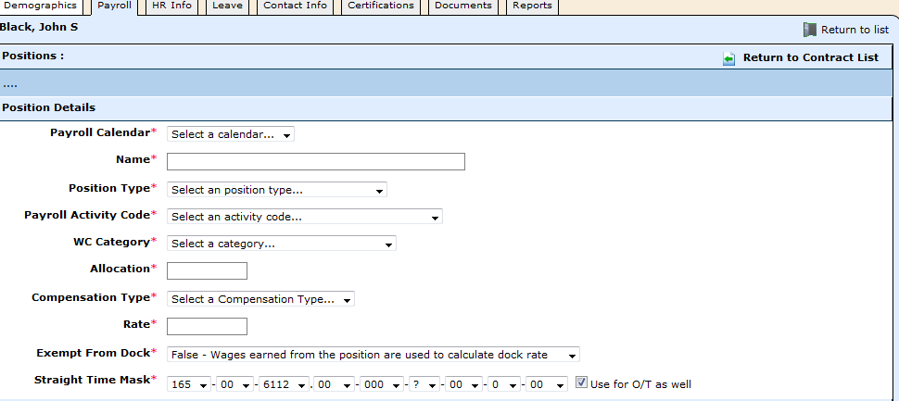
Staff Manager - Positions
Finance > HR > Staff Manager – Payroll tab, Positions
Payroll Calendar – Select the appropriate payroll calendar from the drop down box.
Name – Enter the name of the position of the employee.
Position Type – Select the appropriate position type from the drop down box.
Notes:
Introductions
Go over Day 1 Agenda

Slide 49
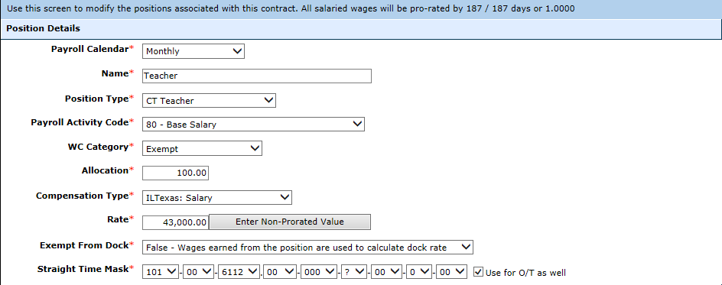
Staff Manager - Positions
Payroll Activity Code – All wage or salary amounts for normal positions are code 80. Please refer to the PEIMS Code Table – Payroll Activity Code. (Click here to view code tables)
WC Category – Select the appropriate Workman’s comp category for the employee’s position from the drop down box.
Allocation – Enter the allocation
•Salary Employees – For PEIMS reporting purposes the percent of the salary is entered into this field.
•Hourly/Daily Employees – Enter 100 in the field.
Notes:
Introductions
Go over Day 1 Agenda

Slide 50
Staff Manager - Positions
Compensation Type – Select the appropriate compensation type for the employee.
Rate – Enter the rate of pay of the employee based on employee’s compensation type.
Enter Non-Prorated Value – select this option if you need to add a stipend to an employee’s pay but do not want it to prorate based on the main contract.
Exempt from Dock – Select if this position is exempt from being docked.
False – Wages earned from the position are used to calculate dock rate
True – Wages earned from the position are NOT used to calculate dock rate
Notes:
Introductions
Go over Day 1 Agenda

Slide 51
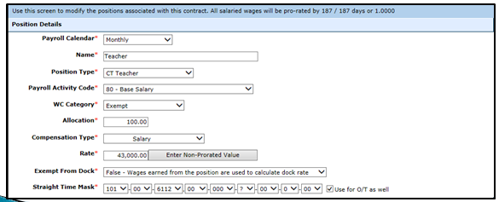
Staff Manager - Positions
Straight Time Mask – Enter the payroll code for this position.
Click here to view FASRG Module 1 for ISD’s, Module 11 for Charters
the box if you choose to use the straight time mask as the overtime code as well.
Notes:
Introductions
Go over Day 1 Agenda

Slide 52
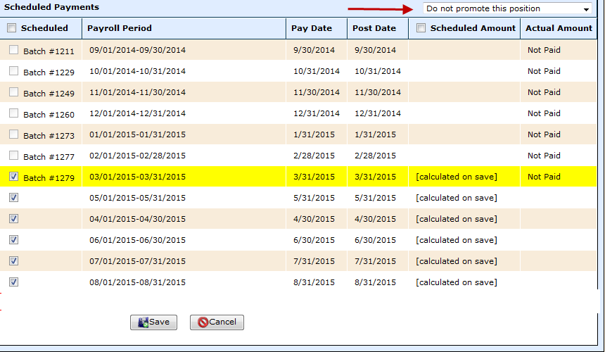
Staff Manager - Positions
Promote Position – Use drop down box to select if this position should promote to the next school year. For example, you may elect not to promote a stipend or extra curricular position.
Check the pay periods in which the employee will receive their pay. If an employee is hired mid-year, you will see payroll batches that indicate “Not Paid” because he/she was not employed when those payroll batches were processed, and you will not be able to select those to be included in their payment schedule.
The available payments will calculate once the payment schedule has been saved. To see the payment schedule, you will have to exit this screen and click back on it to review.
Notes:
Introductions
Go over Day 1 Agenda

Slide 53
Staff Manager - Positions
If an employee has more than one position click Add Position and fill in information for all positions for this employee’s contract.
Click Return to Contract List upon completion of adding all necessary Positions
Notes:
Introductions
Go over Day 1 Agenda

Slide 54
Break
Please take this time to take a brief break.

Slide 55
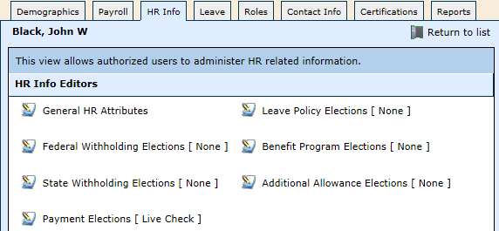
Staff Manager – HR Info
Finance > HR > Staff Manager – HR Info
General HR Attributes
Federal Withholding Elections
State Withholding Elections
Payment Elections
Leave Policy Elections
Benefit Program Elections
Additional Allowance Elections
Notes:
Introductions
Go over Day 1 Agenda

Slide 56
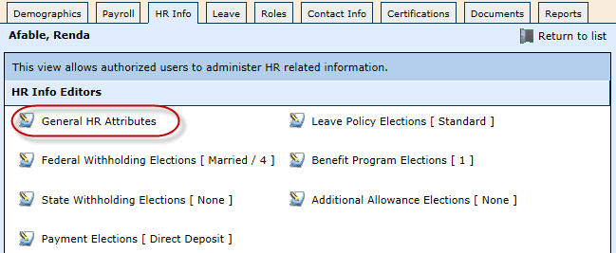
Staff Manager – General HR Attributes
General HR Attributes replaces the previous General Information section in the HR Manager
Notes:
Introductions
Go over Day 1 Agenda

Slide 57
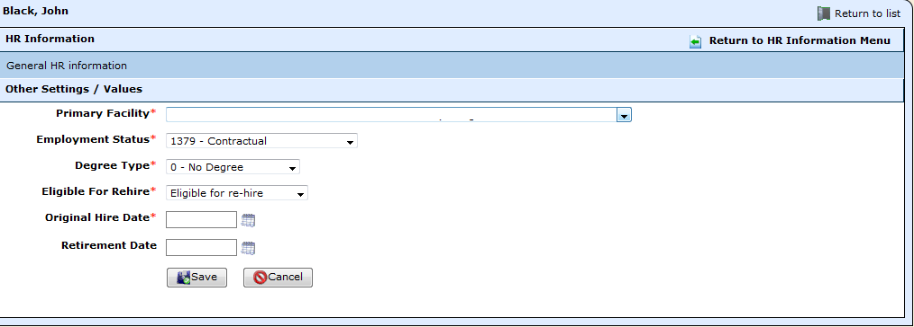
Staff Manager – General HR Attributes
Primary Facility and Employment Status are pre-filled. Can edit.
Degree Type – Select the highest degree the employee has received.
Eligible for Rehire – Upon termination select if the employee is eligible for rehire with the district.
Original Hire Date – Enter the hire date of the employee, MMDDYYYY
Retirement Date – Enter the retirement date of the employee, if applicable, MMDDYYYY
Notes:
Introductions
Go over Day 1 Agenda

Slide 58
Staff Manager – Federal Withholding Elections
The federal withholding tables will now calculate based on the monthly taxable instead of the annualized amount; therefore, if an employee is entered into the system mid-year, their federal withholding deduction amount will be based on their monthly taxable instead of the current annualized salary.
Notes:
Introductions
Go over Day 1 Agenda

Slide 59
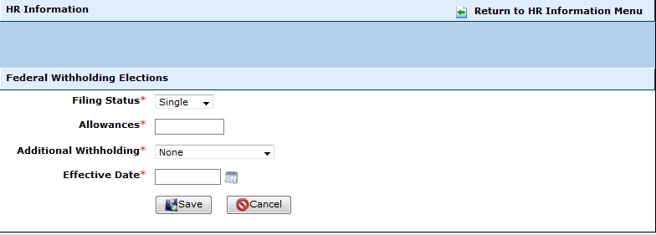
Staff Manager – Federal Withholding Elections
Filing Status – Use drop down box to select which tax table (Single or Married) the employee has elected.
Click here to view publication 15
Allowances – Enter the # of allowances from the employee’s W-4
Additional Withholding – Use the drop down box to select if employee has requested an additional amount to be deducted for withholding. **If this is selected an additional field will appear on the screen.**
Notes:
Introductions
Go over Day 1 Agenda

Slide 60
Staff Manager – State Withholding Elections
State Withholding Elections – None in Texas
Notes:
Introductions
Go over Day 1 Agenda

Slide 61
Staff Manager – Payment Elections
Payment Elections – this feature includes the direct deposit information for the employee.
Click Change Election
Notes:
Introductions
Go over Day 1 Agenda

Slide 62
Staff Manager – Payment Elections
How to set up for an employee to receive a Live Check
Election Type – Select Live Check from the drop down box
Effective Date – Enter the effective date of the payment election
Notes:
Introductions
Go over Day 1 Agenda

Slide 63
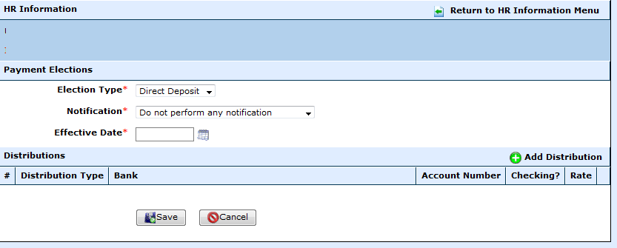
Staff Manager – Payment Elections
How to set up for an employee to receive a Direct Deposit
Election Type – Select Direct Deposit from the drop down box
Notification – Select if a notification (check stub) is sent via email to the employee
Effective Date – Enter the effective date of the payment election
Notes:
Introductions
Go over Day 1 Agenda

Slide 64
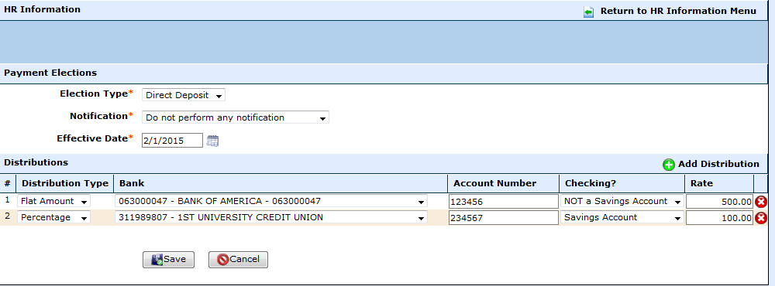
Staff Manager – Payment Elections
Select Add Distribution
Distribution Type - Select the distribution type
Bank - Select the employee’s bank from the drop down box.
Account Number - Enter the employee’s account number for the direct deposit
Checking? - Select if the account is/is not a savings account.
Rate - Enter the rate.
•If distribution type is a percentage then the rate is a percentage. The percentage now HAS to equal 100%.
•If distribution type is a flat amount then the rate is a dollar amount.
Flat amount
Use 100% for remaining of the check
Notes:
Introductions
Go over Day 1 Agenda

Slide 65
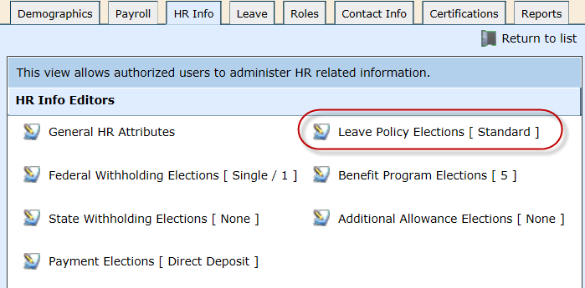
Staff Manager –Leave Policy Elections
Finance > HR > Staff Manager – HR Info tab > Leave Policy Election
To assign a leave policy to an employee
Notes:
Introductions
Go over Day 1 Agenda

Slide 66
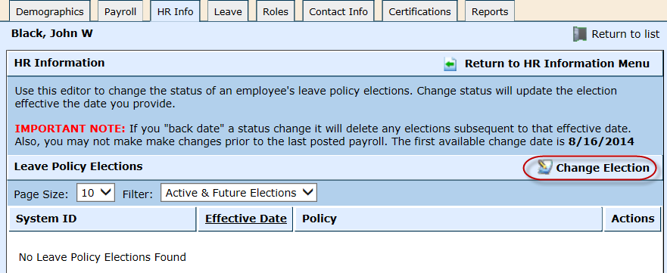
Staff Manager –Leave Policy Elections
Select Change Election to assign leave policy
Notes:
Introductions
Go over Day 1 Agenda

Slide 67
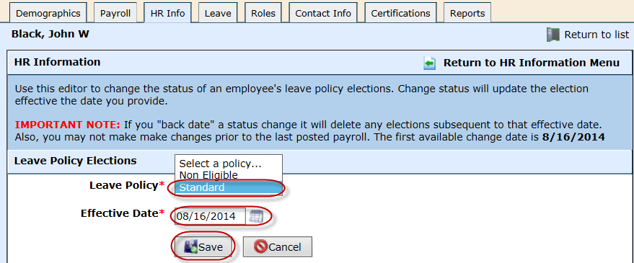
Staff Manager –Leave Policy Elections
Select the Leave Policy for the employee
Enter the Effective Date for the leave to begin
Select Save
Notes:
Introductions
Go over Day 1 Agenda

Slide 68
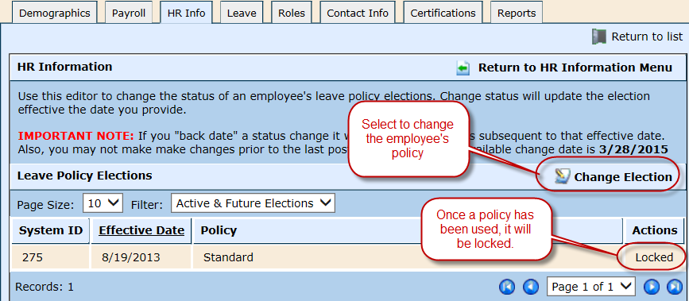
Staff Manager –Leave Policy Elections
To change the employee’s leave policy, select Change Election
If a policy has not been used through the payroll process, you will have the option to edit and/or delete the policy.
Notes:
Introductions
Go over Day 1 Agenda

Slide 69
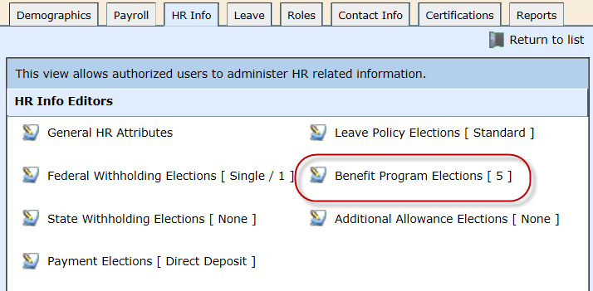
Staff Manager –Benefit Program Elections
The new Benefit Programs section combines the current Payroll Plans and TRS Benefit Groups
Notes:
Introductions
Go over Day 1 Agenda

Slide 70
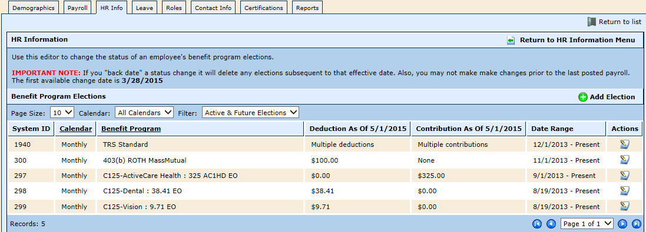
Staff Manager –Benefit Program Elections
Benefit Programs combines Payroll Plans and Benefit Groups from the previous Payroll Configuration screens into one easy to read section
Notes:
Introductions
Go over Day 1 Agenda

Slide 71
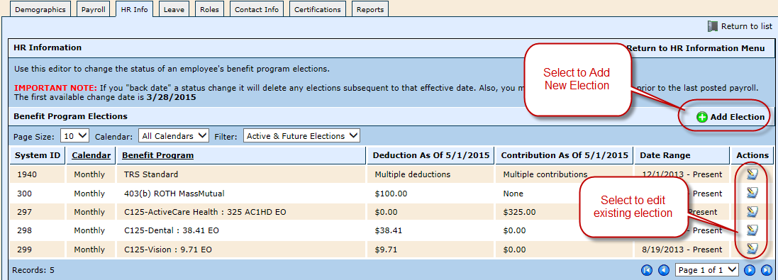
Staff Manager –Benefit Program Elections
Select Add Election to add a new deduction or benefit
Select edit to edit an existing election
Notes:
Introductions
Go over Day 1 Agenda

Slide 72
Staff Manager –Benefit Program Elections
Benefit Programs now have filters as you can see below.
Once a Benefit Program is expired by entering an end date, the Benefit Program will appear in Expired Elections to keep a history of past Benefit Elections.
Notes:
Introductions
Go over Day 1 Agenda

Slide 73
Staff Manager –Benefit Program Elections
Select Add an Election
Benefit Program – Select a benefit program.
Calendar – Select a calendar for the benefit program.
Effective Date – Enter the effective date of the benefit program.
Expiration Date – Enter the expiration date of the benefit program if applicable.
Save
Notes:
Introductions
Go over Day 1 Agenda

Slide 74
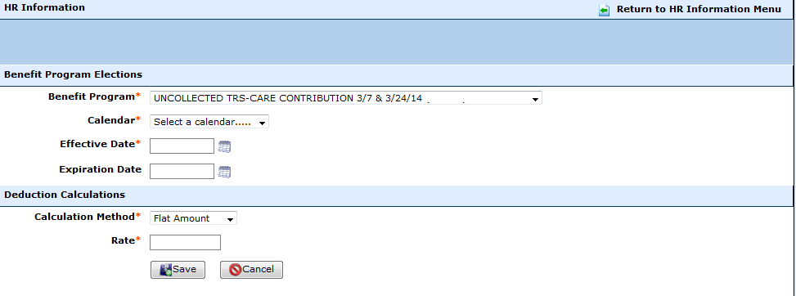
Staff Manager –Benefit Program Elections
If the benefit program was set up with a calculation method of subscription based, offering, or election based, the screen will appear as below:
*Flat Amount or Percentage
Calculation Method - Select if the benefit program is a flat amount or % of earnings
Rate – Enter the rate or the percentage .
Notes:
Introductions
Go over Day 1 Agenda

Slide 75
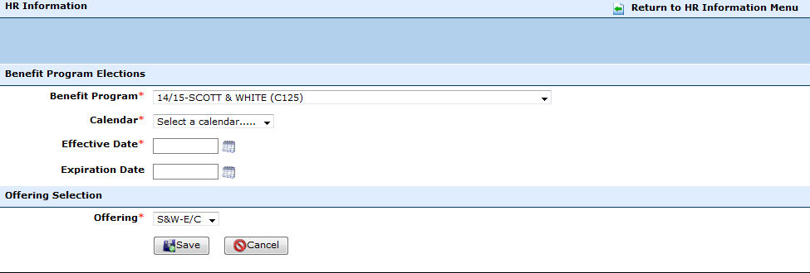
Staff Manager –Benefit Program Elections
If the benefit program was set up with a calculation method of subscription based, offering, or election based, the screen will appear as below:
Offering – Select the appropriate offering for the employee.
Notes:
Introductions
Go over Day 1 Agenda

Slide 76
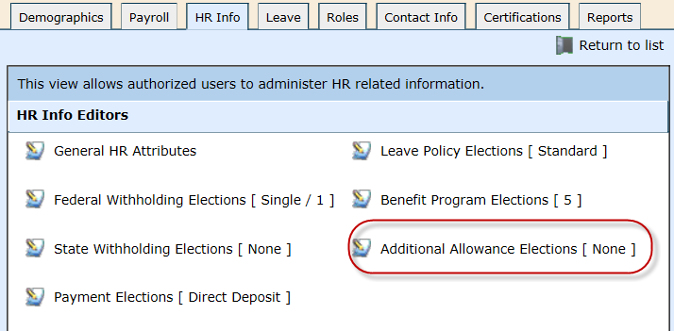
Staff Manager –Additional Allowance Elections
Additional Allowances are designed to assign additional earnings and adjustments to employees either individually or conjointly such as car allowances, cell phone allowances, etc.
Notes:
Introductions
Go over Day 1 Agenda

Slide 77
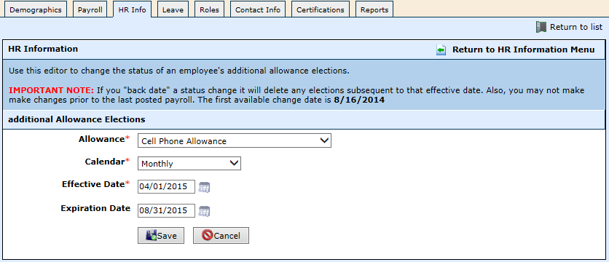
Staff Manager –Additional Allowance Elections
Allowance - Select the allowance. These are preset allowances that were set up in WebSmart at Finance > Payroll > Add'l Allowances.
Calendar – Select a calendar for the additional allowance.
Effective Date – Enter the effective date of the additional allowance for the next available payroll period.
Expiration Date – Enter the expiration date of the additional allowance, if applicable.
Notes:
Introductions
Go over Day 1 Agenda

Slide 78
Staff Manager – Leave
The leave bank represents the selected instructional period's balances by leave type. If you need to manually adjust balances, simply edit the leave type in question and create an adjusting entry.
When entering an employee, you must first Initialize Leave Balances
Select Initial Leave Balances
Notes:
Introductions
Go over Day 1 Agenda

Slide 79
Staff Manager – Leave
Leave - Select the leave that is being adjusted. (State Personal, Sick, Local, etc.)
Balance – Leave blank.
Save
Notes:
Introductions
Go over Day 1 Agenda

Slide 80
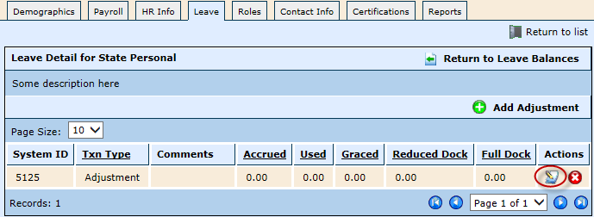
Staff Manager – Leave
Select the edit icon on this screen to enter the initial accrued leave
Notes:
Introductions
Go over Day 1 Agenda

Slide 81
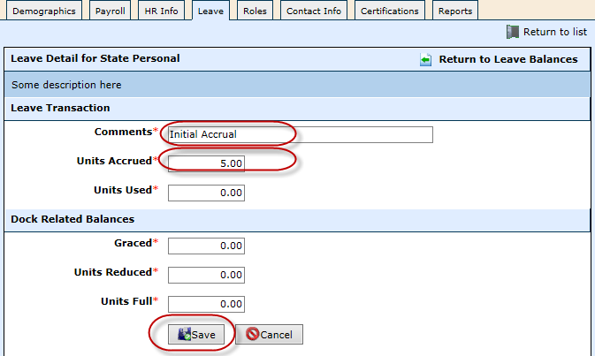
Staff Manager – Leave
Enter Comments to identify the amount you are entering
Units Accrued - Enter the amount of leave to add to the employee
Save
Notes:
Introductions
Go over Day 1 Agenda

Slide 82
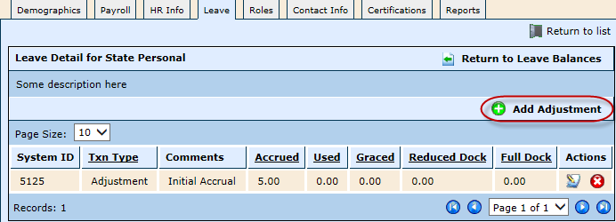
Staff Manager – Leave
To add an adjustment to correct leave, you can enter a correction through a leave form, or you can add the adjustment on the Leave tab
Select Add Adjustment
Notes:
Introductions
Go over Day 1 Agenda

Slide 83
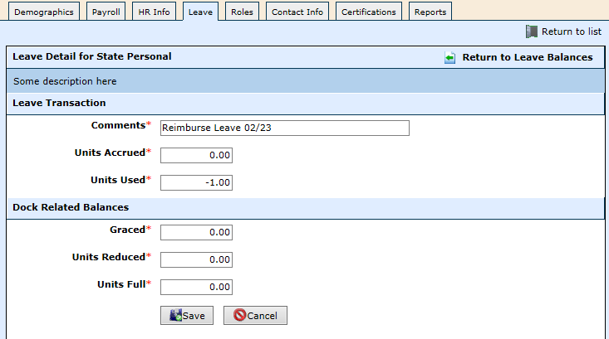
Staff Manager – Leave
Comments – enter any comments to help you identify the leave
Units Used – enter a negative leave amount to adjust the leave. In this example, we chose to reimburse 1 day of leave.
Save
Notes:
Introductions
Go over Day 1 Agenda

Slide 84
Staff Manager – Leave
Employee Leave report – after entering the leave adjustment, you will be able to see it on the Employee Leave report.
Notes:
Introductions
Go over Day 1 Agenda

Slide 85
Staff Manager – Leave
How do I enter a Carry Forward amount from an employee’s previous service record?
Select the previous year. In this example, 2013-2014
Select edit
Notes:
Introductions
Go over Day 1 Agenda

Slide 86
Staff Manager – Leave
Select Add Adjustment
Notes:
Introductions
Go over Day 1 Agenda

Slide 87
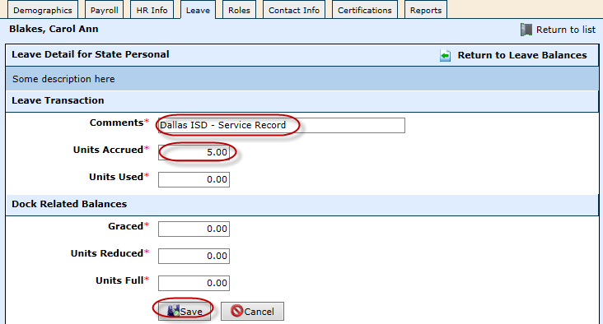
Staff Manager – Leave
Enter Comments
Units Accrued – enter the amount from the employee’s service record
Save
Notes:
Introductions
Go over Day 1 Agenda

Slide 88
Staff Manager – Leave
To verify the Carry Forward amount:
Select Return to Leave Balances
Select the Current Year
Notes:
Introductions
Go over Day 1 Agenda

Slide 89
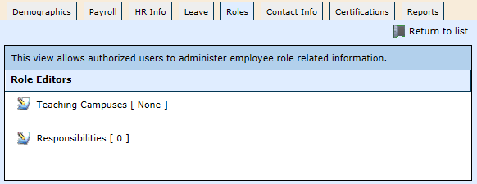
Staff Manager – Role
Roles are used to identify the campus and responsibilities of staff for PEIMS reporting purposes and access to Gradebook.
Teaching Campuses - Use this editor to authorize and restrict an employee's ability to be selected as a teacher on a given campus
Responsibilities – Use this editor to assign responsibilities for staff, which creates 090 records (Staff Data Responsibilities) for PEIMS reporting in the Fall PEIMS file.
Notes:
Introductions
Go over Day 1 Agenda

Slide 90
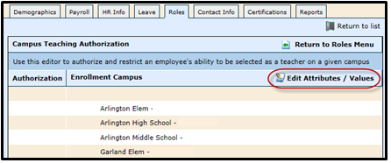
Staff Manager – Role
Teaching Campuses
Select Edit Attributes/Values to assign a staff member to a campus or multiple campuses
Assigning teachers to specific campuses will release the teacher to the scheduler module
Notes:
Introductions
Go over Day 1 Agenda

Slide 91
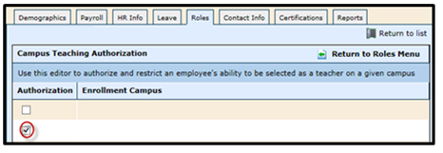
Staff Manager – Role
Check the box for each campus to assign to the staff
Select Save
Notes:
Introductions
Go over Day 1 Agenda

Slide 92
Staff Manager – Role
Responsibilities – Teacher responsibilities will be released from the schedule module during the PEIMS process. You will need to add responsibilities for all other PEIMS reportable staff. See the PEIMS Data Standards page for further clarification. Click Here
Select Add Responsibilities
Notes:
Introductions
Go over Day 1 Agenda

Slide 93
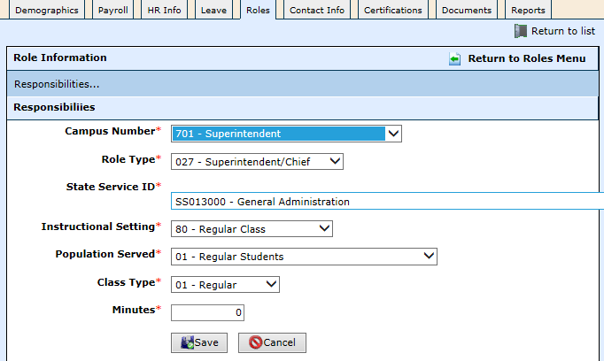
Staff Manager – Role
Enter the employee’s role according to PEIMS Data Standards. Click Here to view PEIMS Data Standards
The Campus Number is now available in the drop down menu.
Save.
Notes:
Introductions
Go over Day 1 Agenda

Slide 94
Staff Manager – Role
Select to edit the role responsibility
Select to delete the role responsibility.
Notes:
Introductions
Go over Day 1 Agenda

Slide 95
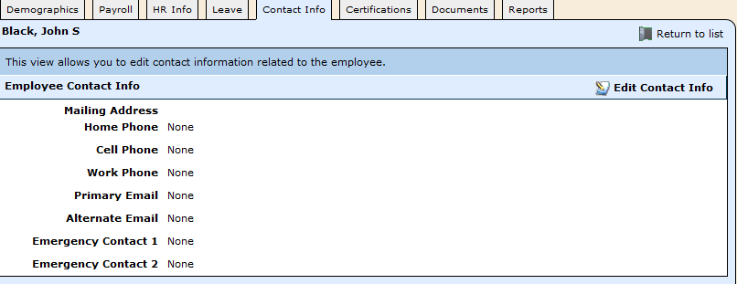
Staff Manager – Contact Info
Contact Info – This view allows you to edit contact information related to the employee.
Select Edit Contact Info to enter the employee’s contact information.
Notes:
Introductions
Go over Day 1 Agenda

Slide 96
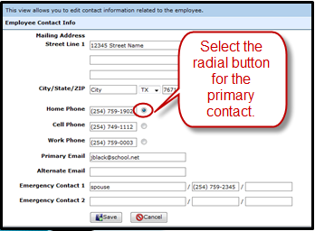
Staff Manager – Contact Info
Contact Info – enter the employee’s contact information
Phone Numbers – select the radial button for the primary contact.
Select Save
Emergency Contact 1 & 2 – These are free form fields available for you to enter the employee’s contact information from their applications. (Name. Phone number. Phone number.)
Notes:
Introductions
Go over Day 1 Agenda

Slide 97
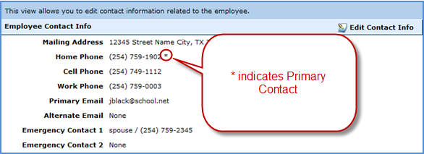
Staff Manager – Contact Info
Contact Info – the * to the right of the phone number indicates the Primary Contact for that employee.
Notes:
Introductions
Go over Day 1 Agenda

Slide 98
Staff Manager – Certifications
Certifications - The areas in which an employee is eligible to teach based on the certification source. The current list of specialization certifications listed on this screen are preloaded SBOE’s list of endorsements available to date.
Select Add Certification
Notes:
Introductions
Go over Day 1 Agenda

Slide 99
Staff Manager – Certifications
Specialization – Select a specialization from the drop down menu. This will be on the employee’s teaching certificate.
Primary Source – Select the source of the specialization, i.e. SBEC, Alternative Certification, etc.
Highly Qualified – Select if the employee is highly qualified based on the following link TEA - HQ page
Effective Date– Enter the effective date of the certification.
Save
Notes:
Introductions
Go over Day 1 Agenda

Slide 100
Staff Manager – Certifications
Highly Qualified – True or False - once the determination is made on the HQ status of an employee, the prompt will show “True.” If at any point, the status needs to be False, click on the yellow star to indicate False.
To expire a certification – if an employee’s certification has expired, select the edit button to go to the next screen.
Notes:
Introductions
Go over Day 1 Agenda

Slide 101
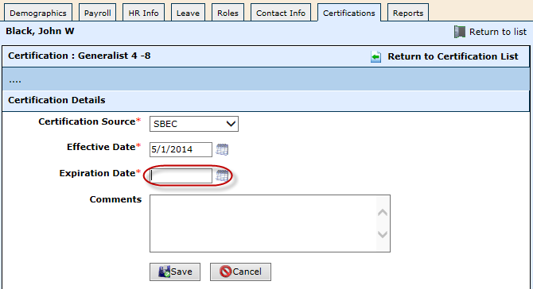
Staff Manager – Certifications
Expiration Date – enter the expiration date of the certification
Select Save
Notes:
Introductions
Go over Day 1 Agenda

Slide 102
Staff Manager – Documents
Documents – if you have purchased WebSmart-i, you will see a Documents tab and have the ability to upload the personnel file here.
You are allowed to upload documents of any size.
Notes:
Introductions
Go over Day 1 Agenda

Slide 103
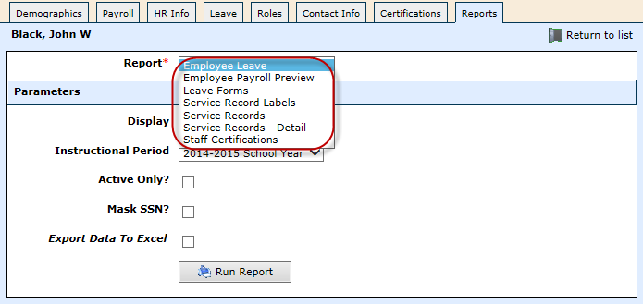
Staff Manager – Reports
Reports – You now have access to many reports from the employee’s HR screen.
Select any report and complete the parameters
Select Run Report.
New Reports –
Employee Payroll Preview – this was previously found on the employee’s Position History screen
Staff Certifications – lists all certifications for that staff member
Notes:
Introductions
Go over Day 1 Agenda

Slide 104
Resources
To review detailed instructions, click on the links below:
Documents for Training
Notes:
Introductions
Go over Day 1 Agenda

Slide 105
Symposiums
If you haven’t signed up for one of WebSmart’s EOY Summer Symposiums, click here to register now!!
June 10th HR/Payroll
June 11th Finance/Budget
June 24th HR/Payroll
June 25th Finance/Budget
July 15th HR/Payroll
July 16th Finance/Budget
Notes:
Introductions
Go over Day 1 Agenda

Slide 106
Questions

Slide 107
Acronyms
HR – Human Resources
SBOE – State Board of Education
TRS – Teacher Retirement System of Texas
PEIMS – Public Education Information Management System
FTE – Full Time Equivalent
FUTA – Federal Unemployment Tax Act
SUTA – State Unemployment Tax Act

Slide 108
Customer Support Options!
Remember if you get stuck, we have 24 hour/7 days a week customer support:
Email the WebSmart Help Desk at Support@websmart.freshdesk.com
Call us at 1-888-759-1902
Visit our Website at www.jr3online.com and click on Software Support (password is jr3)

