Slide 1
JR3 Webinar
Software Release – New Payroll

Slide 2
Coming Soon
WebSmart is excited to announce the new version of HR & Payroll.
Be prepared in advance.
Coming June 2015.
Notes:
Introductions
Go over Day 1 Agenda

Slide 3
Available Webinars - HR
Feel free to attend any or all of our training sessions to discuss these new changes.
Tuesday, May 12th 9:00 am - 1:00 pm
Thursday, May 21st 9:00 am - 1:00 pm
Wednesday, May 27th 9:00 am - 1:00 pm
Notes:
Introductions
Go over Day 1 Agenda

Slide 4
Introduction/Goals
Welcome and thank you for joining us today.
Introduction of Presenters
Melissa Davis – mdavis@jr3online.com
CTSBS Certification in Accounting
Annette Miller – amiller@jr3online.com
Notes:
Introductions
Go over Day 1 Agenda

Slide 5
Conversion Schedule
We are developing a conversion schedule this week and submit to the individual districts as soon as it becomes available.
Notes:
Introductions
Go over Day 1 Agenda

Slide 6
Introduction/Goals
Today’s Agenda
Discuss new features in Payroll setup
Compensation types
Calendars
Additional allowances
Benefit Programs
Discuss new features in Payroll Processing
Entering leave forms
Ability to view prior batches
Correcting HR setup in the payroll batch
Messages and statuses
Documents tab
Reports available in the payroll batch
Termination of employees
Adding stipends and changing contracts mid-year
Wage Base Corrections
Click here for Documentation and Power Points
Notes:
Introductions
Go over Day 1 Agenda

Slide 7
Payroll Setup – Compensation Types
Finance > Payroll > Pay Schedules > Compensation Types
This view allows you to configure ranged or stepped scales.
These will be converted from Pay Schedules > Local.
The Compensation Types are selected on the Employee's Record in Finance > HR > Staff Manager on the Position screen.
Select Add Compensation Type to add a new one.
Notes:
Introductions
Go over Day 1 Agenda

Slide 8
Payroll Setup – Compensation Types
Enter a Name for your Compensation Type. In this example, we will show you how to create a Compensation Type using a pay scale.
Enter the Compensation Rate: Annual (or Salary), Hourly, Daily.
Select Create
Notes:
Introductions
Go over Day 1 Agenda

Slide 9
Payroll Setup – Compensation Types
Click on the Pay Scales tab
Select Update Scale
Notes:
Introductions
Go over Day 1 Agenda

Slide 10
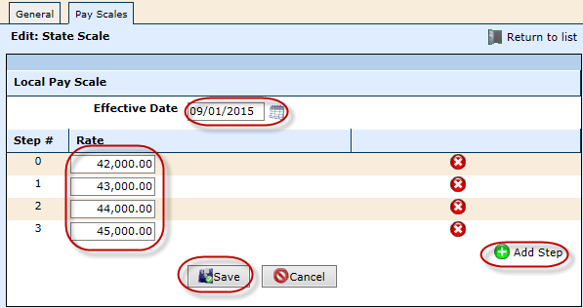
Payroll Setup – Compensation Types
Enter the Effective Date – if you are working in current year but have already received the pay scale for next year, you can enter it now. Pay Scales are based on the effective date.
Select Add Step
Enter the Rate – the annual amount for that step
Continue adding steps until you are finished
Select Save
Notes:
Introductions
Go over Day 1 Agenda

Slide 11
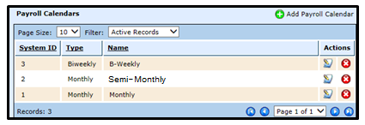
Payroll Setup – Calendars
Finance > Payroll > Pay Schedules > Calendars
Payroll Calendars are used during the payroll process to include pay periods according to the type of payroll.
Select to Add Payroll Calendar if you are changing payroll calendars.
Select to edit an existing payroll calendar to add new pay periods.
Notes:
Introductions
Go over Day 1 Agenda

Slide 12
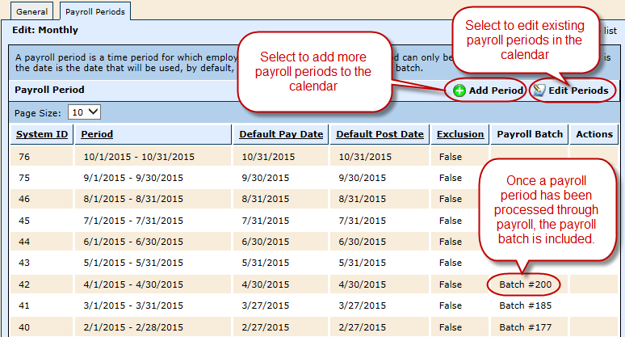
Payroll Setup – Calendars
To add Payroll Periods, select the Payroll Periods tab
Notes:
Introductions
Go over Day 1 Agenda

Slide 13
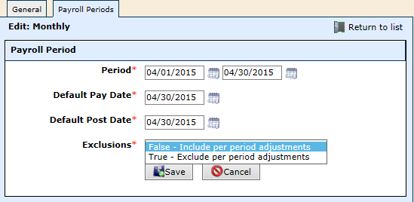
Payroll Setup – Calendars
To add Payroll Periods, enter the following information. Each pay period can only be used once.
Period – begin and end date of the payroll period
Default Pay Date – enter the pay date
Default Post Date – enter the post date
Exclusions
False – Include per period adjustments
True – Exclude per period adjustments
Save
Notes:
Introductions
Go over Day 1 Agenda

Slide 14
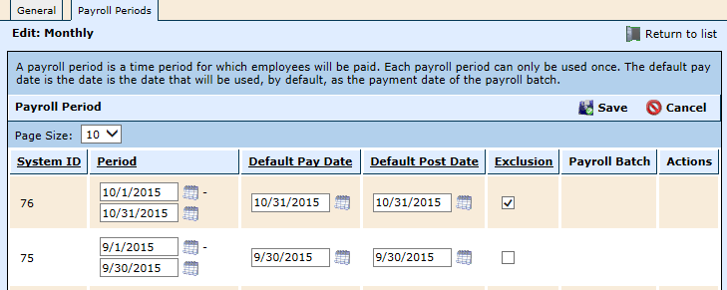
Payroll Setup – Calendars
To edit Payroll Periods, update any of the following information. If the payroll batch has been processed for that period, you will not be able to edit it.
Period – begin and end date of the payroll period
Default Pay Date
Default Post Date
Exclusions
False – Include per period adjustments (leave the box unchecked)
True – Exclude per period adjustments (check the box)
Save
Notes:
Introductions
Go over Day 1 Agenda

Slide 15
Payroll Setup – Additional Allowances
Finance > Payroll > Add'l Allowances
Additional Allowances are designed to assign additional earnings and adjustments to employees. For each tax treatment a new additional allowance will need to be set up reflecting that tax treatment.
The Additional Allowance is set up on the employee in HR > Staff Manager – HR Info > Additional Allowances Elections.
Select Add Additional Allowance
Notes:
Introductions
Go over Day 1 Agenda

Slide 16
Payroll Setup – Additional Allowances
Enter the following information:
Name – Enter the description of the allowance. This will be the description on the check and check stub.
Description – Select the appropriate activity code for the allowance.
Payroll Tax Treatment – Select the tax treatment for the allowance.
State Benefit Status – Select if the allowance is/is not qualified for TRS.
Workers Comp – Enter in the workers comp code for the wages.
Effective Date – Enter the effective date of the allowance.
Expense Account Mask – Enter the expense code for the allowance.
Calculation Method – Select the calculation method associated with the allowance.
Rate – Enter the rate of the allowance based on the calculation method entered.
Select Create
Notes:
Introductions
Go over Day 1 Agenda

Slide 17
Payroll Setup – Additional Allowances
Once a tax treatment has been selected, and the Additional Allowance has been saved, it cannot be changed.
When selecting tax treatments, consider the following in your determination:
Exempt from FICA – FICA will not be withheld
Exempt from FICA, Medicare, State – FICA, Medicare or SUTA will be not withheld
Exempt from FICA, State – FICA or SUTA will not be withheld
Exempt from Nothing – no statutory amounts will be withheld
Exempt from State – SUTA will not be withheld
Exempt from Withholding, FICA, Medicare – Federal W/H, FICA or Medicare will not be withheld
Exempt from Withholding, FICA, Medicare, State – Federal w/h, FICA, Medicare or SUTA will not be withheld
Exempt from Withholding, FICA, State – Federal W/H, FICA, or SUTA will not be withheld
Exempt from Withholding, State – Federal w/h or SUTA will not be withheld
Notes:
Introductions
Go over Day 1 Agenda

Slide 18
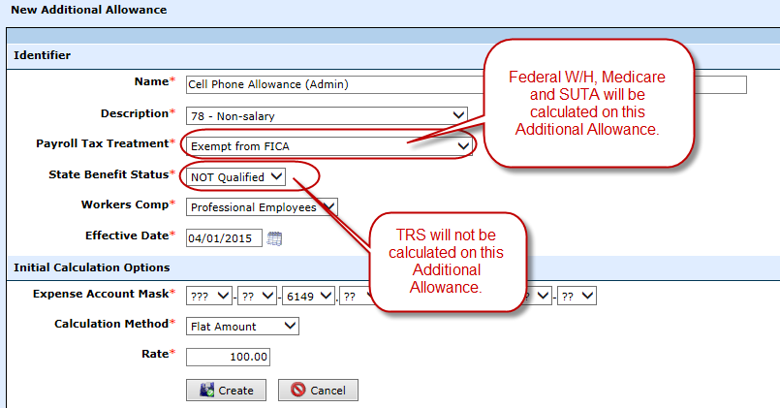
Payroll Setup – Additional Allowances
Example:
Notes:
Introductions
Go over Day 1 Agenda

Slide 19
Payroll Setup – Benefit Programs
Finance > Payroll > Benefit Programs
A benefit program is any program to which an employee may elect non-statutory deductions and/or contributions to be applied to his/her paycheck. (These are a combination of previous Payroll Plans and Benefit Groups.)
There are two primary types of plans:
Subscription Based – includes all TRS plans in which an employee is subscribed. (This does not include TRS ActiveCare-health insurance). WebSmart will update these as needed.
Election Based (or Flat Amount) - the plan or the employee's election into the plan are used to determine the amount of the deduction and/or contribution.
Offering Based - the plan itself is configured with several "options" to which an employee elects. It is the option they select that determines the amount of the deduction and/or contribution. Within offering based, there are two types: fixed contribution and fixed deduction. In each case, the "fixed" element is calculated and the balance is applied to the remaining element.
Notes:
Introductions
Go over Day 1 Agenda

Slide 20
Payroll Setup – Benefit Programs
How do I add a new Benefit Program that is Pre-Tax with offerings? (Offering Based)
Finance > Payroll > Benefit Programs
Select Add Benefit Programs
Notes:
Introductions
Go over Day 1 Agenda

Slide 21
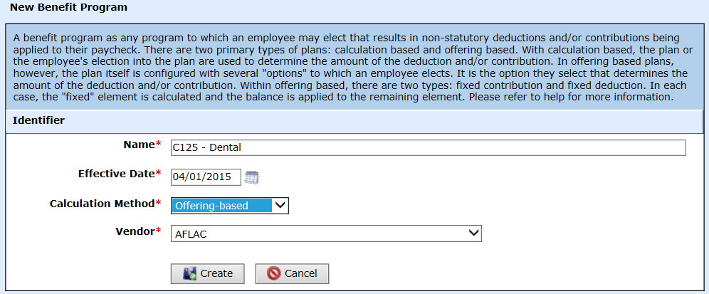
Payroll Setup – Benefit Programs
Name – enter a description for the program
Effective Date – enter the effective date
Select the calculation method – Select Offering-Based
Select the Vendor associated with the Benefit
Select Create
Notes:
Introductions
Go over Day 1 Agenda

Slide 22
Payroll Setup – Benefit Programs
Edit Identifier– Select Edit Identifier to select the Calculation Timing.
Calculate BEFORE Statutories are Calculated – Pre-Tax Deductions
Calculate AFTER Statutories are Calculated – After Tax Deductions
Notes:
Introductions
Go over Day 1 Agenda

Slide 23
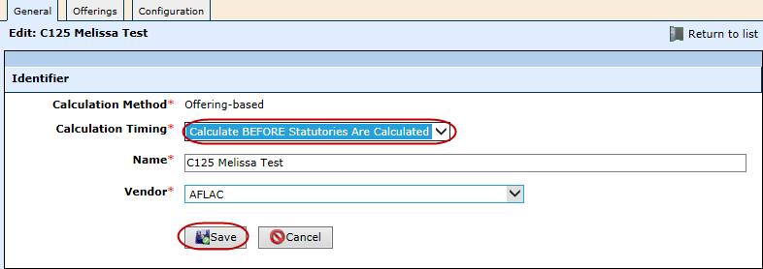
Payroll Setup – Benefit Programs
Save – Select Save
Notes:
Introductions
Go over Day 1 Agenda

Slide 24
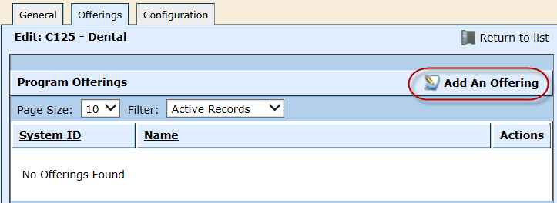
Payroll Setup – Benefit Programs
Set the Offerings for the Benefit Type
Click on the Offerings tab
Select Add An Offering
Examples would be for insurance:
EO – Employee Only
ES – Employee Spouse
EC – Employee and Children
EF – Employee and Family
Notes:
Introductions
Go over Day 1 Agenda

Slide 25
Payroll Setup – Benefit Programs
Enter the Name of the Offering. Examples: EO, ES, EC, EF
Select Save
Notes:
Introductions
Go over Day 1 Agenda

Slide 26
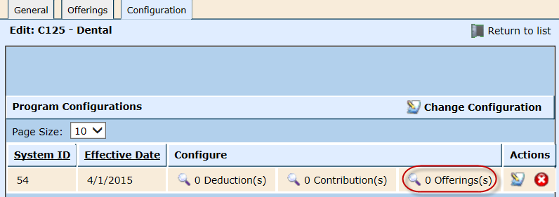
Payroll Setup – Benefit Programs
Set the Configuration for the Benefit
Click on the Configuration tab to begin the setup.
Each program may have a different configuration based upon an effective date.
When setting up the configuration, you must set up in the following order: Offering(s) , the Deduction(s), and then the Contribution(s) in order for the benefit to calculate correctly.
Select Offerings
Notes:
Introductions
Go over Day 1 Agenda

Slide 27
Payroll Setup – Benefit Programs
Select Edit Amounts to enter the amount of the offering
Notes:
Introductions
Go over Day 1 Agenda

Slide 28
Payroll Setup – Benefit Programs
Enter the total cost of the premium.
Select Save.
Select Return to Configuration Menu.
Notes:
Introductions
Go over Day 1 Agenda

Slide 29
Payroll Setup – Benefit Programs
Next select Deductions to set up the benefit’s tax treatment, calculation method and coding.
Notes:
Introductions
Go over Day 1 Agenda

Slide 30
Payroll Setup – Benefit Programs
Select Add Deduction
Notes:
Introductions
Go over Day 1 Agenda

Slide 31
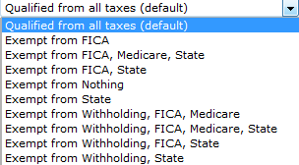
Payroll Setup – Benefit Programs
Enter the information about the deduction according to the prompts.
Payroll Tax Treatment – The tax treatments are now preset categories. Use the drop down box to select the appropriate tax treatment.
Notes:
Introductions
Go over Day 1 Agenda

Slide 32
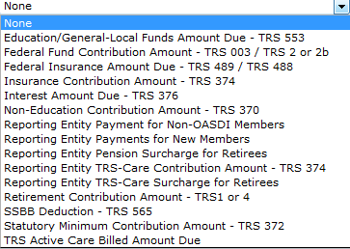
Payroll Setup – Benefit Programs
Adjustment Category – use the drop down box to select the appropriate adjustment category, if applicable.
Notes:
Introductions
Go over Day 1 Agenda

Slide 33
Payroll Setup – Benefit Programs
Calculation Method –Use the drop down box to select the appropriate calculation method for the employee contribution.
Liability Account Mask –Remember this MUST be completed.
W2 Reporting – Use the drop down box to select the appropriate W-2 Reporting code.
Select Save
Notes:
Introductions
Go over Day 1 Agenda

Slide 34
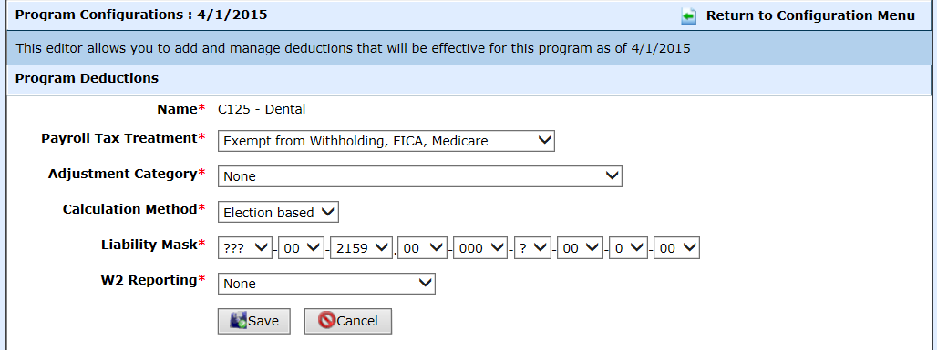
Payroll Setup – Benefit Programs
Deduction set up
Select Return to Configuration Menu to set up the Contributions
Notes:
Introductions
Go over Day 1 Agenda

Slide 35
Payroll Setup – Benefit Programs
Next Select the Contributions to enter any district contribution amount.
Notes:
Introductions
Go over Day 1 Agenda

Slide 36
Payroll Setup – Benefit Programs
Enter the information about the Contribution to determine how the election will be calculated.
Payroll Tax Treatment – The tax treatments are now preset categories. Use the drop down box to select the appropriate tax treatment.
Notes:
Introductions
Go over Day 1 Agenda

Slide 37
Payroll Setup – Benefit Programs
Adjustment Category –Use the drop down box to select the appropriate adjustment category if applicable
Notes:
Introductions
Go over Day 1 Agenda

Slide 38
Payroll Setup – Benefit Programs
Calculation Method – Use the drop down box to select the appropriate calculation method for the employee contribution. If the District is paying a portion of the premium, you must select Flat Amount
Not to exceed – Enter the cap amount that will be contributed for this benefit program.
Expense Mask – Enter the expense mask or at the very least the object code. If everything else is left with question marks it will default to the employees payroll expense code except for the object code that was entered.
Liability Account Mask –Remember this MUST be completed.
Notes:
Introductions
Go over Day 1 Agenda

Slide 39
Payroll Setup – Benefit Programs
W2 Reporting – Use the drop down box to select the appropriate W-2 Reporting code.
Select Save
Notes:
Introductions
Go over Day 1 Agenda

Slide 40
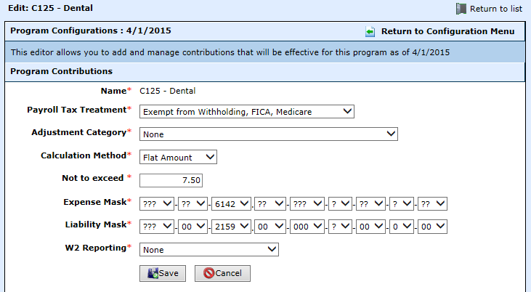
Payroll Setup – Benefit Programs
Contribution Setup
Notes:
Introductions
Go over Day 1 Agenda

Slide 41
Payroll Setup – Benefit Programs
Contribution Setup
Notes:
Introductions
Go over Day 1 Agenda

Slide 42
Payroll Setup – Benefit Programs
How do I add a new Benefit Program that is After-Tax that is Election-Based (or using a flat amount)?
Finance > Payroll > Benefit Programs
Select Add Benefit Programs
Notes:
Introductions
Go over Day 1 Agenda

Slide 43
Payroll Setup – Benefit Programs
Name – enter a description for the program
Effective Date – enter the effective date
Select the calculation method – This time you will select Election-Based
Select the Vendor
Select Create
Notes:
Introductions
Go over Day 1 Agenda

Slide 44
Payroll Setup – Benefit Programs
Select Edit Identifier
Calculation Timing defaults to calculate BEFORE Statutories are calculated.
Notes:
Introductions
Go over Day 1 Agenda

Slide 45
Payroll Setup – Benefit Programs
Select Calculate AFTER Statutories are Calculated for after tax deductions or Calculate BEFORE Statutories are Calculated for Pre-Tax deductions.
Select Save
Notes:
Introductions
Go over Day 1 Agenda

Slide 46
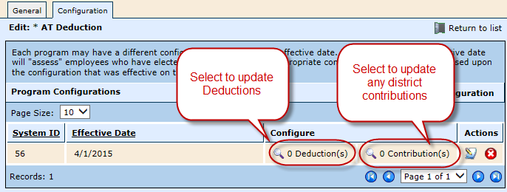
Payroll Setup – Benefit Programs
Set the Configurations for the Benefit Type
Click on Configuration
The configuration process HAS to be set up in the following order: Deduction (or Election Based Calculation) > Contribution (or Flat Based Calculations)
Select Deductions to update the employee deduction.
Select Contributions to update any employer contributions, if applicable.
Notes:
Introductions
Go over Day 1 Agenda

Slide 47
Payroll Setup – Benefit Programs
Select Add Deduction
Notes:
Introductions
Go over Day 1 Agenda

Slide 48
Payroll Setup – Benefit Programs
Enter Name of the benefit
Payroll Tax Treatment – The tax treatments are now preset categories. Use the drop down box to select the appropriate tax treatment. If it is an after tax deduction, select Exempt from FICA.
Adjustment Category –Use the drop down box to select the appropriate adjustment category if applicable.
Calculation Method –Use the drop down box to select the appropriate calculation method for the employee contribution.
Liability Account Mask –Remember this MUST be completed.
W2 Reporting – Use the drop down box to select the appropriate W-2 Reporting code.
Select Save.
Notes:
Introductions
Go over Day 1 Agenda

Slide 49
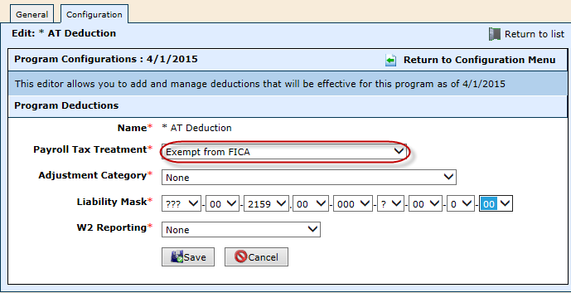
Payroll Setup – Benefit Programs
Election Based Deduction
Notes:
Introductions
Go over Day 1 Agenda

Slide 50
Payroll Setup – Benefit Programs
To Set Up the Contribution for the Benefit:
If the district contributes to the benefit, select Add Contribution
Notes:
Introductions
Go over Day 1 Agenda

Slide 51
Payroll Setup – Benefit Programs
Enter the information as indicated.
Payroll Tax Treatment – The tax treatments are now preset categories. Use the drop down box to select the appropriate tax treatment.
Adjustment Category –Use the drop down box to select the appropriate adjustment category if applicable
Calculation Method – Use the drop down box to select the appropriate calculation method for the employee contribution. If the District is paying a portion of the premium, you must select Flat Amount
Not to exceed – Enter the cap amount that will be contributed for this benefit program.
Expense Mask – Enter the expense mask or at the very least the object code. If everything else is left with question marks it will default to the employees payroll expense code except for the object code that was entered.
Liability Account Mask –Remember this MUST be completed.
W2 Reporting – Use the drop down box to select the appropriate W-2 Reporting code.
Select Save
Notes:
Introductions
Go over Day 1 Agenda

Slide 52
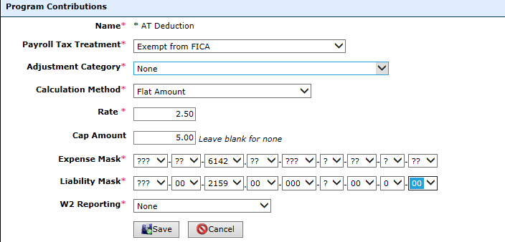
Payroll Setup – Benefit Programs
Election Based Contribution
Notes:
Introductions
Go over Day 1 Agenda

Slide 53
Break
Please take this time to take a brief break.

Slide 54
Payroll Batch Processing - Leave
HR > Leave > Leave forms
Enter Leave Forms prior to creating the payroll batch
Select Add Leave Form
Notes:
Introductions
Go over Day 1 Agenda

Slide 55
Payroll Batch Processing - Leave
To Enter a Leave Form(s) – multiple leave forms can now be entered on one screen
Enter the Employee
Select the Instructional Period
Est. Leave Balances – The employee’s available leave is listed.
Leave Type – select the Leave Type applicable to the leave
Comments – enter Comments such as dates, reasons for absence, etc.
TRS Contract Month – defaults to current month, but this may be changed to a previous or later month, dependent upon the leave.
Units Used – enter the employee’s time off
Process on or After – select the payroll in which to include the leave. Future dates can be used.
Save – select Save to complete the leave forms
Notes:
Introductions
Go over Day 1 Agenda

Slide 56
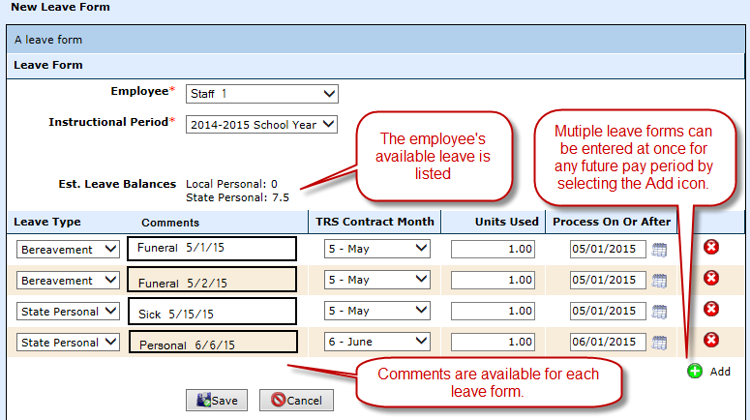
Payroll Batch Processing - Leave
Leave Form(s)
Notes:
Introductions
Go over Day 1 Agenda

Slide 57
Payroll Batch Processing
You now have the ability to view prior batches!
Select the (magnifying glass) to view prior batches and unpaid batches.
Notes:
Introductions
Go over Day 1 Agenda

Slide 58
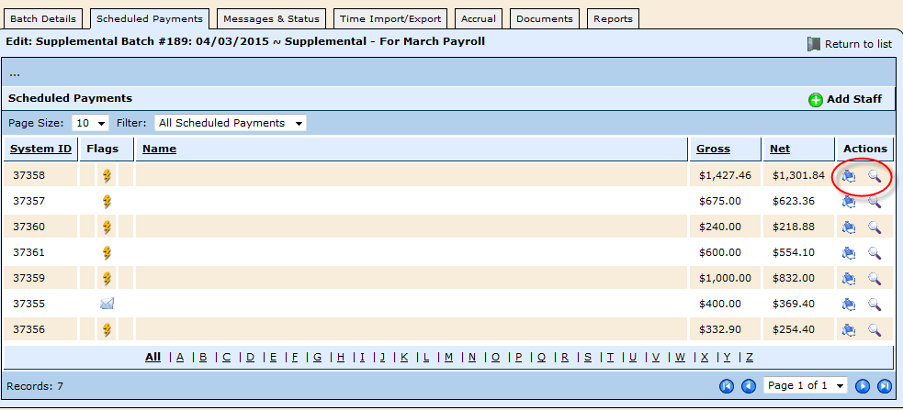
Payroll Batch Processing
Select the (magnifying glass) to view an employee’s payroll record within the batch.
Select the (printer icon) to view the individual journal.
Notes:
Introductions
Go over Day 1 Agenda

Slide 59
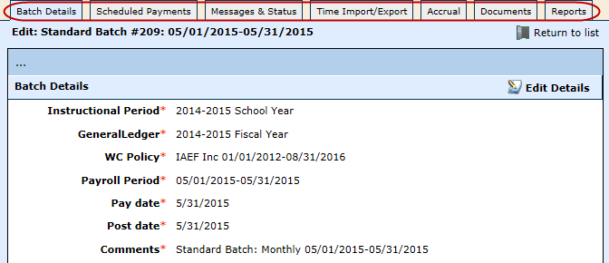
Payroll Batch Processing
Select any tab to view information about a prior payroll batch and to maneuver in current payroll batches.
Batch Details – contains information about the payroll batch
Scheduled Payments – lists employees and their pay
Messages & Status – lists errors. Also the place to submit the batch.
Time Import/Export – provides an export/import feature to import time.
Accrual – coming soon. This will be discussed at a later date.
Documents – WebSmarti allows the ability to upload documents.
Reports – payroll reports are now available to view within the batch.
Notes:
Introductions
Go over Day 1 Agenda

Slide 60
Payroll Batch Processing
Finance > Payroll > Processing > Payroll Batches
Creating a payroll batch has not changed.
Select Create Payroll Batch
Notes:
Introductions
Go over Day 1 Agenda

Slide 61
Payroll Batch Processing
The payments are already scheduled in the Calendars as we discussed earlier.
To process a standard payroll batch according to your payroll calendars, select the Payroll Period.
Select Create.
Notes:
Introductions
Go over Day 1 Agenda

Slide 62
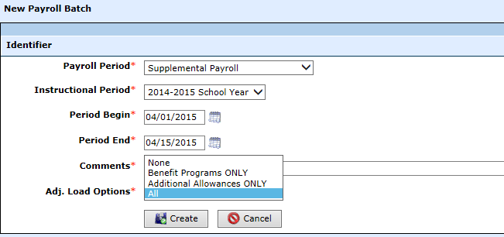
Payroll Batch Processing
To create a supplemental, select Supplemental Payroll
Select the Instructional Period – the system will default to current
Select Period Begin and End Dates
Enter Comments
Adj. Load Options – select the appropriate adjustment load options
None – select if you want statutory deductions taken out only
Benefit Programs ONLY – select if you want to include statutory and Benefits
Additional Allowances ONLY – select if you want to include statutory and additional allowances
Notes:
Introductions
Go over Day 1 Agenda

Slide 63
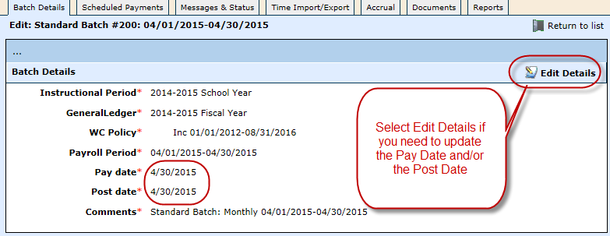
Payroll Batch Processing
Batch Details contain information including the instructional period, general ledger, Workers Comp Policy, Payroll Period, Pay Date and Post Date and Comments to identify the batch.
Edit Details – select if you need to update the Pay Date and/or the Post Date
Notes:
Introductions
Go over Day 1 Agenda

Slide 64
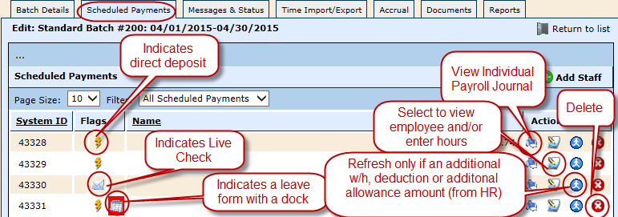
Payroll Batch Processing
Scheduled Payments – most of the icons remain the same as indicated in the screenshot below.
Notes:
Introductions
Go over Day 1 Agenda

Slide 65
Payroll Batch Processing
To Add Staff to the Batch:
Select to Add Staff
Notes:
Introductions
Go over Day 1 Agenda

Slide 66
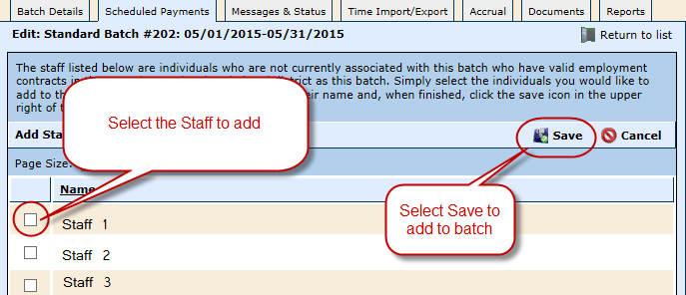
Payroll Batch Processing
Staff is now provided to you in an alphabetical list.
Select the checkbox(es) for the appropriate staff.
Select Save.
Notes:
Introductions
Go over Day 1 Agenda

Slide 67
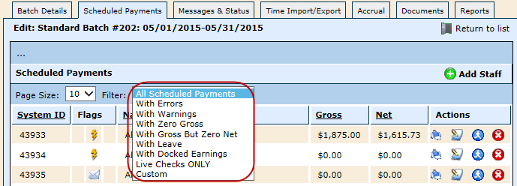
Payroll Batch Processing
Filter – Several queries are available to view specific items.
Select any of the categories to view
(Note: With Warnings – this is coming soon.)
Notes:
Go to alpha to review

Slide 68
Payroll Batch Processing
To Edit Staff – Select the edit icon to edit and/or view staff
Employees highlighted in red are terminated in WebSmart.
Notes:
Go to alpha to review

Slide 69
Payroll Batch Processing
The staff information within the Scheduled Payments is broken down into several segments.
Employee: Staff 1 – by selecting the Employee, this feature directs the user to the employee’s HR Staff Manager screen, where the user can make any necessary changes and return back to the batch.
Notes:
Go to alpha to review

Slide 70
Payroll Batch Processing
To return to the payroll batch, select Return to batch once all changes have been made in HR.
Notes:
Go to alpha to review

Slide 71
Payroll Batch Processing
Edit Time/Days – Select Edit Time/Days to enter hours and/or days for the employee.
Add Earnings – Select Add Earnings to add/edit hours and/or add additional earnings.
Notes:
Go to alpha to review

Slide 72
Payroll Batch Processing
Edit Time/Days – Select to add hours and/or days to an employee.
Select Save
Notes:
Go to alpha to review

Slide 73
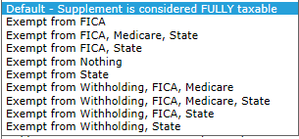
Payroll Batch Processing
Add Earnings – Select Add Earnings to add/edit hours and/or add additional earnings.
Allowance - the allowance can be a One-Time or a preset Additional Allowance that can be selected from the menu
Name – enter a description of the One-Time allowance
Payroll Tax Treatment – the tax treatment defaults to Supplement is considered FULLY Taxable. If the supplemental pay should be exempt from any item, select from the menu.
Notes:
Go to alpha to review

Slide 74
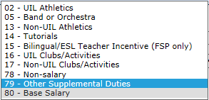
Payroll Batch Processing
Payroll Activity Code – select the Payroll Activity code
Workers Comp – select the appropriate workers comp code
Performance Pay – defaults to Does NOT represent performance pay. Be careful of changing this to Performance Pay. The district must first submit a form to TRS prior to marking anything performance pay. See Form 596
Notes:
Go to alpha to review

Slide 75
Payroll Batch Processing
Distribution – defaults to Supplemental is State Retirement System Qualified. If the additional earnings are not TRS qualified, be sure to select Supplemental is NOT state Retirement System qualified.
Amount - enter the amount of the additional earnings or allowance.
Expense Mask - defaults to all ?’s, which will expense to the employee’s main position code(s).
Select Save
Notes:
Go to alpha to review

Slide 76
Payroll Batch Processing
Leave –
Select Units Taken to add any additional leave for the employee.
Shows dock amount for the employee leave if there is not any leave available.
Notes:
Go to alpha to review

Slide 77
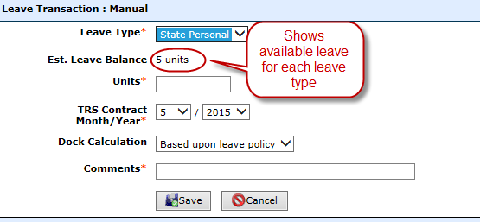
Payroll Batch Processing
To Enter Leave in the Payroll Batch –
Select Leave Type
Est. Leave Balance – indicates the amount of available leave for that leave type.
Units – enter the amount of leave
TRS Contract Month/Year – this defaults to the current month. If leave needs to be reported for a prior month, select a different date, which will create an RP15 for TRAQS.
Dock Calculation –
Based upon leave policy
Manual – enter $ amount
Comments - enter
Select Save
Notes:
Go to alpha to review

Slide 78
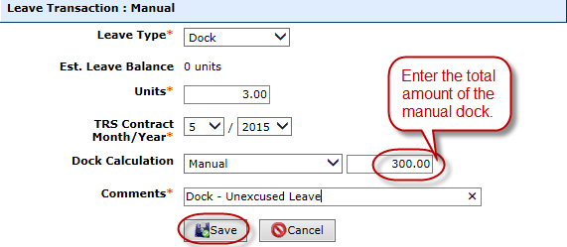
Payroll Batch Processing
To Enter a Manual Dock in the Payroll Batch –
Select Leave Type
Est. Leave Balance – indicates the amount of available leave for that leave type.
Units – enter the amount of leave
TRS Contract Month/Year – this defaults to the current month. If leave needs to be reported for a prior month, select a different date, which will create an RP15 for TRAQS.
Dock Calculation –
Select Manual
Enter $ amount
Comments - enter
Select Save
Notes:
Go to alpha to review

Slide 79
Payroll Batch Processing
Statutory Adjustments –
Shows all of the employee’s statutory adjustments for this payroll check including the eligibility, taxable gross, contribution amounts and deduction amounts.
Notes:
Go to alpha to review

Slide 80
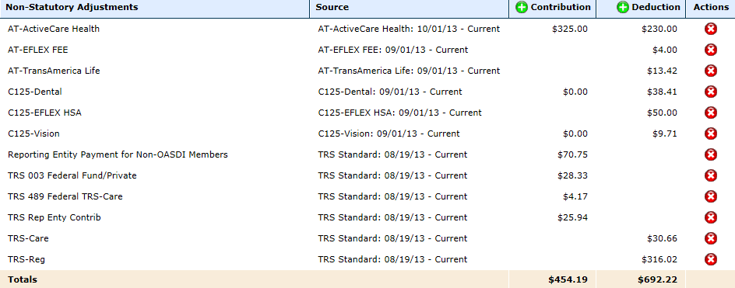
Payroll Batch Processing
Non-Statutory Adjustments –
Shows all of the employee’s non-statutory adjustments for this payroll check including the source of the benefit, contribution amounts and deduction amounts.
A benefit CAN be deleted from the payroll batch.
Notes:
Go to alpha to review

Slide 81
Payroll Batch Processing
To Add Non-Statutory Adjustments –
Select to add a Contribution
Select to add a Deduction
Notes:
Go to alpha to review

Slide 82
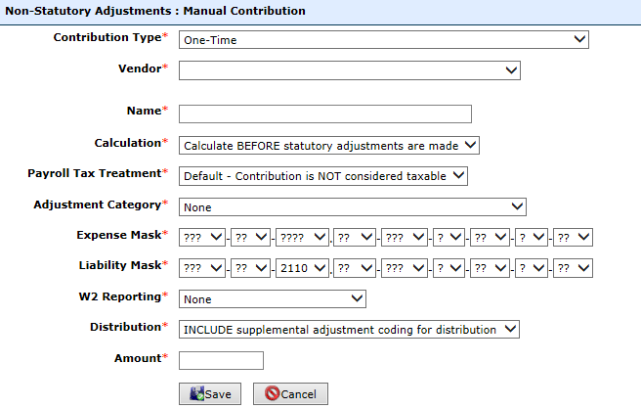
Payroll Batch Processing
To Add Non-Statutory Adjustments – Contribution
Notes:
Go to alpha to review

Slide 83
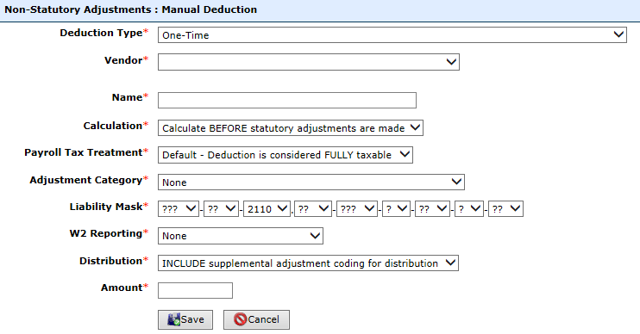
Payroll Batch Processing
To Add Non-Statutory Adjustments – Deduction
Notes:
Go to alpha to review

Slide 84
Payroll Batch Processing
Payroll Journal Entry–
Shows all of the transactions, which will generate as the result of the employee’s payroll being processed.
Notes:
Go to alpha to review

Slide 85
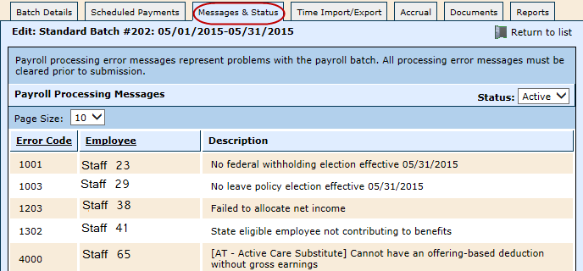
Payroll Batch Processing
Messages & Status – lists errors, which will need to be corrected before submitting the payroll batch.
Notes:
Introductions
Go over Day 1 Agenda

Slide 86
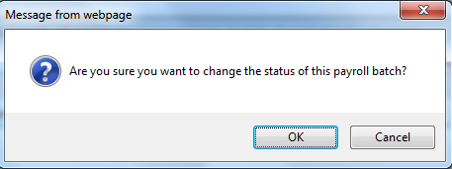
Payroll Batch Processing
Messages & Status – Submit the Payroll here.
Submitted – once all the errors have been resolved, select Submitted to submit the payroll batch for processing.
Select OK
Notes:
Introductions
Go over Day 1 Agenda

Slide 87
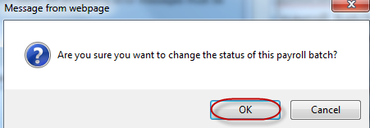
Payroll Batch Processing
Messages & Status – UnSubmit the Payroll here.
The payroll batch can be unsubmitted in this section.
Select Active to unsubmit the payroll batch.
The following prompt will appear.
Select OK.
Notes:
Introductions
Go over Day 1 Agenda

Slide 88
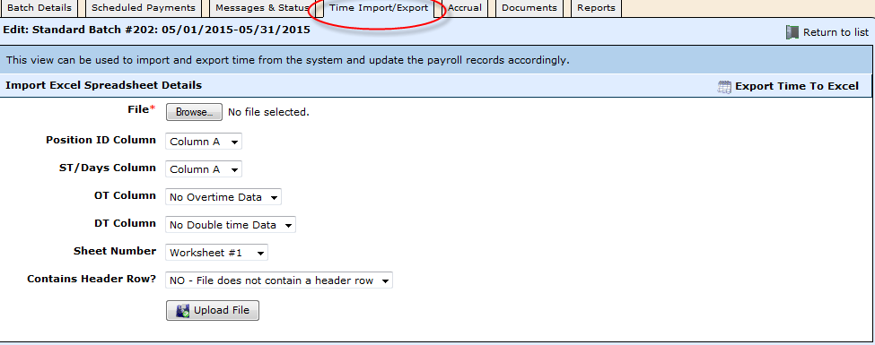
Payroll Batch Processing
Time Import/Export – allows you to export and import time and update records in the payroll batch
Select Export Time to Excel
Notes:
Introductions
Go over Day 1 Agenda

Slide 89
Payroll Batch Processing
Time Import/Export – allows you to export and import time and update records in the payroll batch
Select Export Time to Excel
Enter hours
When importing back to WebSmart, verify the columns
Notes:
Introductions
Go over Day 1 Agenda

Slide 90
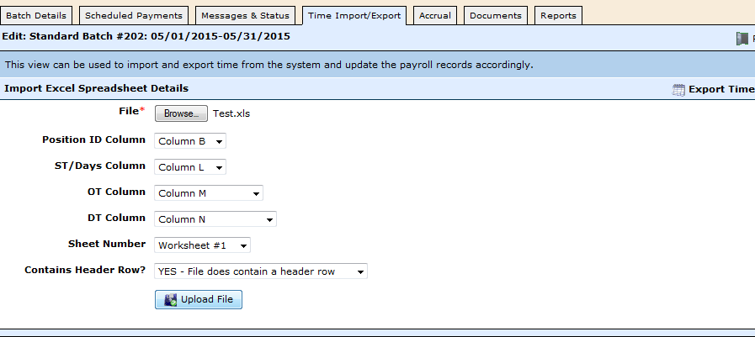
Payroll Batch Processing
Identify the fields in the exported spreadsheet when you get ready to import the hours back into WebSmart.
Notes:
Introductions
Go over Day 1 Agenda

Slide 91
Payroll Batch Processing
Accruals – to be discussed at a later date.
Notes:
Introductions
Go over Day 1 Agenda

Slide 92
Payroll Batch Processing
Documents – if you have purchased WebSmart-i, you will see a Documents tab and have the ability to upload the supporting documents for your payroll batch here.
You are allowed to upload documents of any size.
Select Upload File
Once uploaded, the batch number, period pay date, period begin and period end dates automatically populate.
Notes:
Introductions
Go over Day 1 Agenda

Slide 93
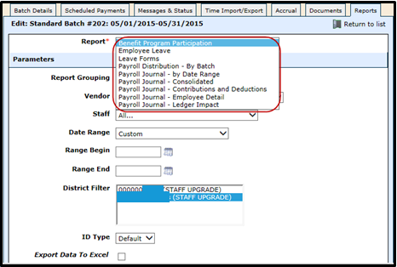
Payroll Batch Processing
Reports are now available on a Reports tab within the payroll batch.
Notes:
Introductions
Go over Day 1 Agenda

Slide 94
Break
Please take this time to take a brief break.

Slide 95
Termination of Employee
Finance > HR > Staff Manager
Payroll tab
Select the icon to terminate the employee
Notes:
Introductions
Go over Day 1 Agenda

Slide 96
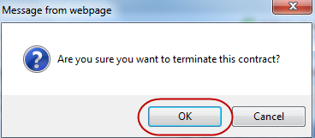
Termination of Employee
Select OK if you are sure you want to terminate this contract.
Notes:
Introductions
Go over Day 1 Agenda

Slide 97
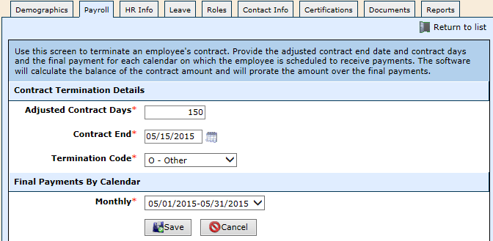
Termination of Employee
Enter all the termination information for the employee:
Adjusted Contract Days – enter the # of days the employee worked for the contract
Contract End – enter the last day the employee worked
Termination Code – select the appropriate termination code
Final Payments By Calendar – Select the pay period in which the employee will receive his/her payoff.
Save.
Notes:
Introductions
Go over Day 1 Agenda

Slide 98
Termination of Employee
Filter – since the contract has now been terminated, you will see it in the Terminated Contracts list
Select the Positions icon to review the payment schedule for the payoff.
Notes:
Introductions
Go over Day 1 Agenda

Slide 99
Termination of Employee
Select the edit icon to review the payment schedule of each position
Notes:
Introductions
Go over Day 1 Agenda

Slide 100
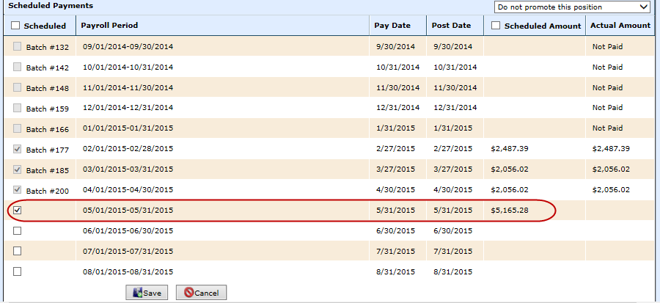
Termination of Employee
Scheduled Payments – calculates the employee’s payoff
Notes:
Introductions
Go over Day 1 Agenda

Slide 101
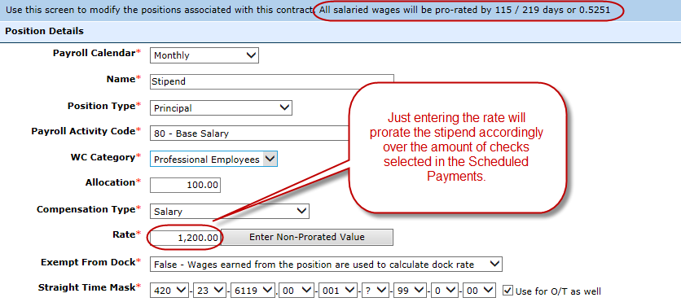
Adding Stipend Mid-Year
Finance > HR > Staff Manager – Payroll tab, edit Position
If an employee is hired later on in the year and should receive a stipend, there are a couple ways to address this payment.
Notes:
Introductions
Go over Day 1 Agenda

Slide 102
Adding Stipend Mid-Year
Select the payroll periods in which the employee is to receive the stipend.
Select Save
The stipend amount will automatically prorate after you click Save.
Notes:
Introductions
Go over Day 1 Agenda

Slide 103
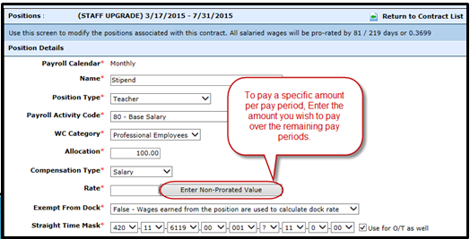
Adding Stipend Mid-Year
To pay a specific amount per pay period, select Enter Non-Prorated Value. For example, if you want to pay $400 a month for the remainder of 3 months, enter a total of $1,200 ($400 x 3).
Notes:
Introductions
Go over Day 1 Agenda

Slide 104
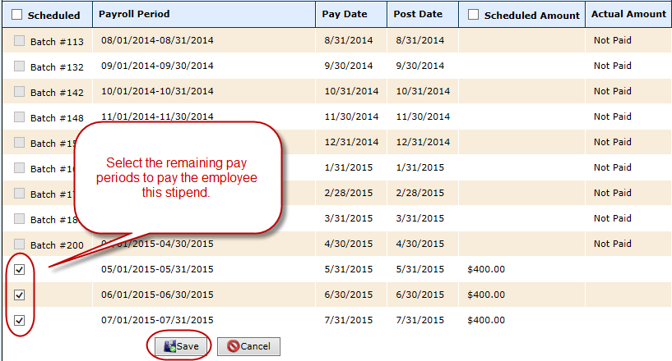
Adding Stipend Mid-Year
Once you save the Stipend and select to return to the Position, the amount will be calculated and appear on the Scheduled Payments screen. You will see the $400 per pay period amount. You can also pay the Stipend over lesser periods.
Notes:
Introductions
Go over Day 1 Agenda

Slide 105
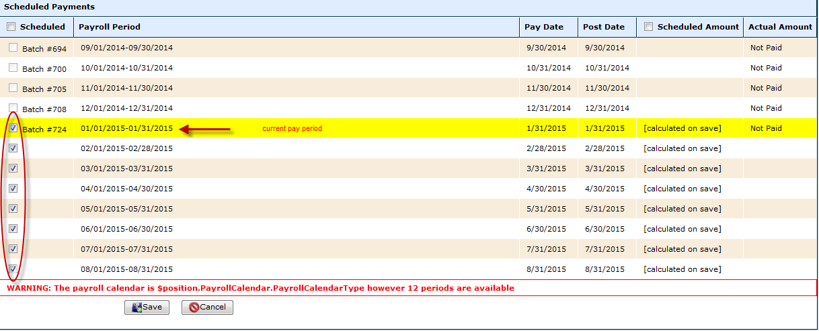
Adding Stipend Mid-Year
If a pay period is highlighted in yellow, the payroll batch is unsubmitted and it can be used and added to the payroll.
Click here for complete instructions
Notes:
Introductions
Go over Day 1 Agenda

Slide 106
Changing Contracts Mid-Year
How do I change an employee’s contract in the middle of the year?
Click here for documentation
Notes:
Introductions
Go over Day 1 Agenda

Slide 107
Wage Base Corrections
This documentation will explain in detail how to complete a wage base adjustment to correct an employee's year-to-date (YTD) taxable wages and tax deduction for all statutory deductions such as Withholding, Social Security, Medicare and SUTA. All adjustments are made in a supplemental batch.
Common scenarios that might occur and that can be corrected by doing a wage base adjustment:
Refund FICA
Refund Medicare
Refund Extra Withholding
Deduct FICA
Deduct Medicare
Click here for documentation
Notes:
Introductions
Go over Day 1 Agenda

Slide 108
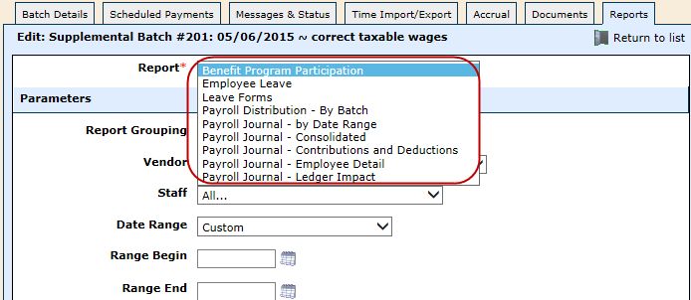
Reports – Payroll Journals
Reports tab – Payroll reports are now available directly in the payroll batch.
Benefit Program Participation is the former Payroll Plan Participation report
Notes:
Introductions
Go over Day 1 Agenda

Slide 109
Resources
To review detailed instructions, click on the link below:
Documents for Training
Notes:
Introductions
Go over Day 1 Agenda

Slide 110
Symposiums
If you haven’t signed up for one of WebSmart’s EOY Summer Symposiums, click here to register now!!
June 10th HR/Payroll
June 11th Finance/Budget
June 24th HR/Payroll
June 25th Finance/Budget
July 15th HR/Payroll
July 16th Finance/Budget
Notes:
Introductions
Go over Day 1 Agenda

Slide 111
Questions

Slide 112
Customer Support Options!
Remember if you get stuck, we have 24 hour/7 days a week customer support:
Email the WebSmart Help Desk at Support@websmart.freshdesk.com
Call us at 1-888-759-1902
Visit our Website at www.jr3online.com and click on Software Support (password is jr3)

